Slide 1
Making New Orleans a Better Home

Slide 2
FANO History
BACKGROUND AND COMMUNITY INVESTMENT HISTORY

Slide 3
Our
Mission
To improve the quality of life in
the city of New Orleans by investing
in affordable housing and economic development programs that produce
quality jobs and wealth for its residents.
© THE FINANCE AUTHORITY OF NEW ORLEANS
3

Slide 4
FANO has invested $650 million into New Orleans since 1978
benefiting over 7,500 families
2005: HURRICANE KATRINA
2007: GREAT RECESSION
Single Family
Multifamily
Economic Dev

Slide 5
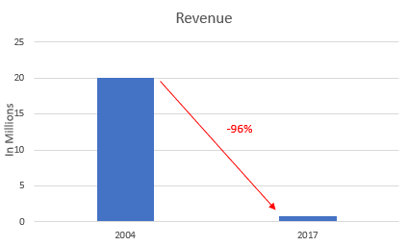
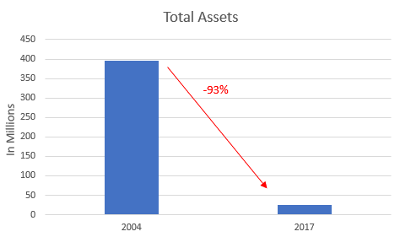
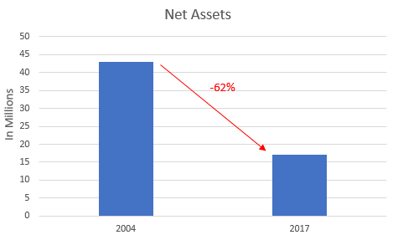
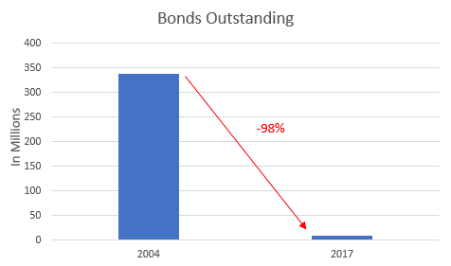
Hurricane Katrina and the Great Recession severely impacted our financial condition

Slide 6
5-Year Strategic Plan
STRATEGIC VISION & OPERATING PRIORITIES

Slide 7
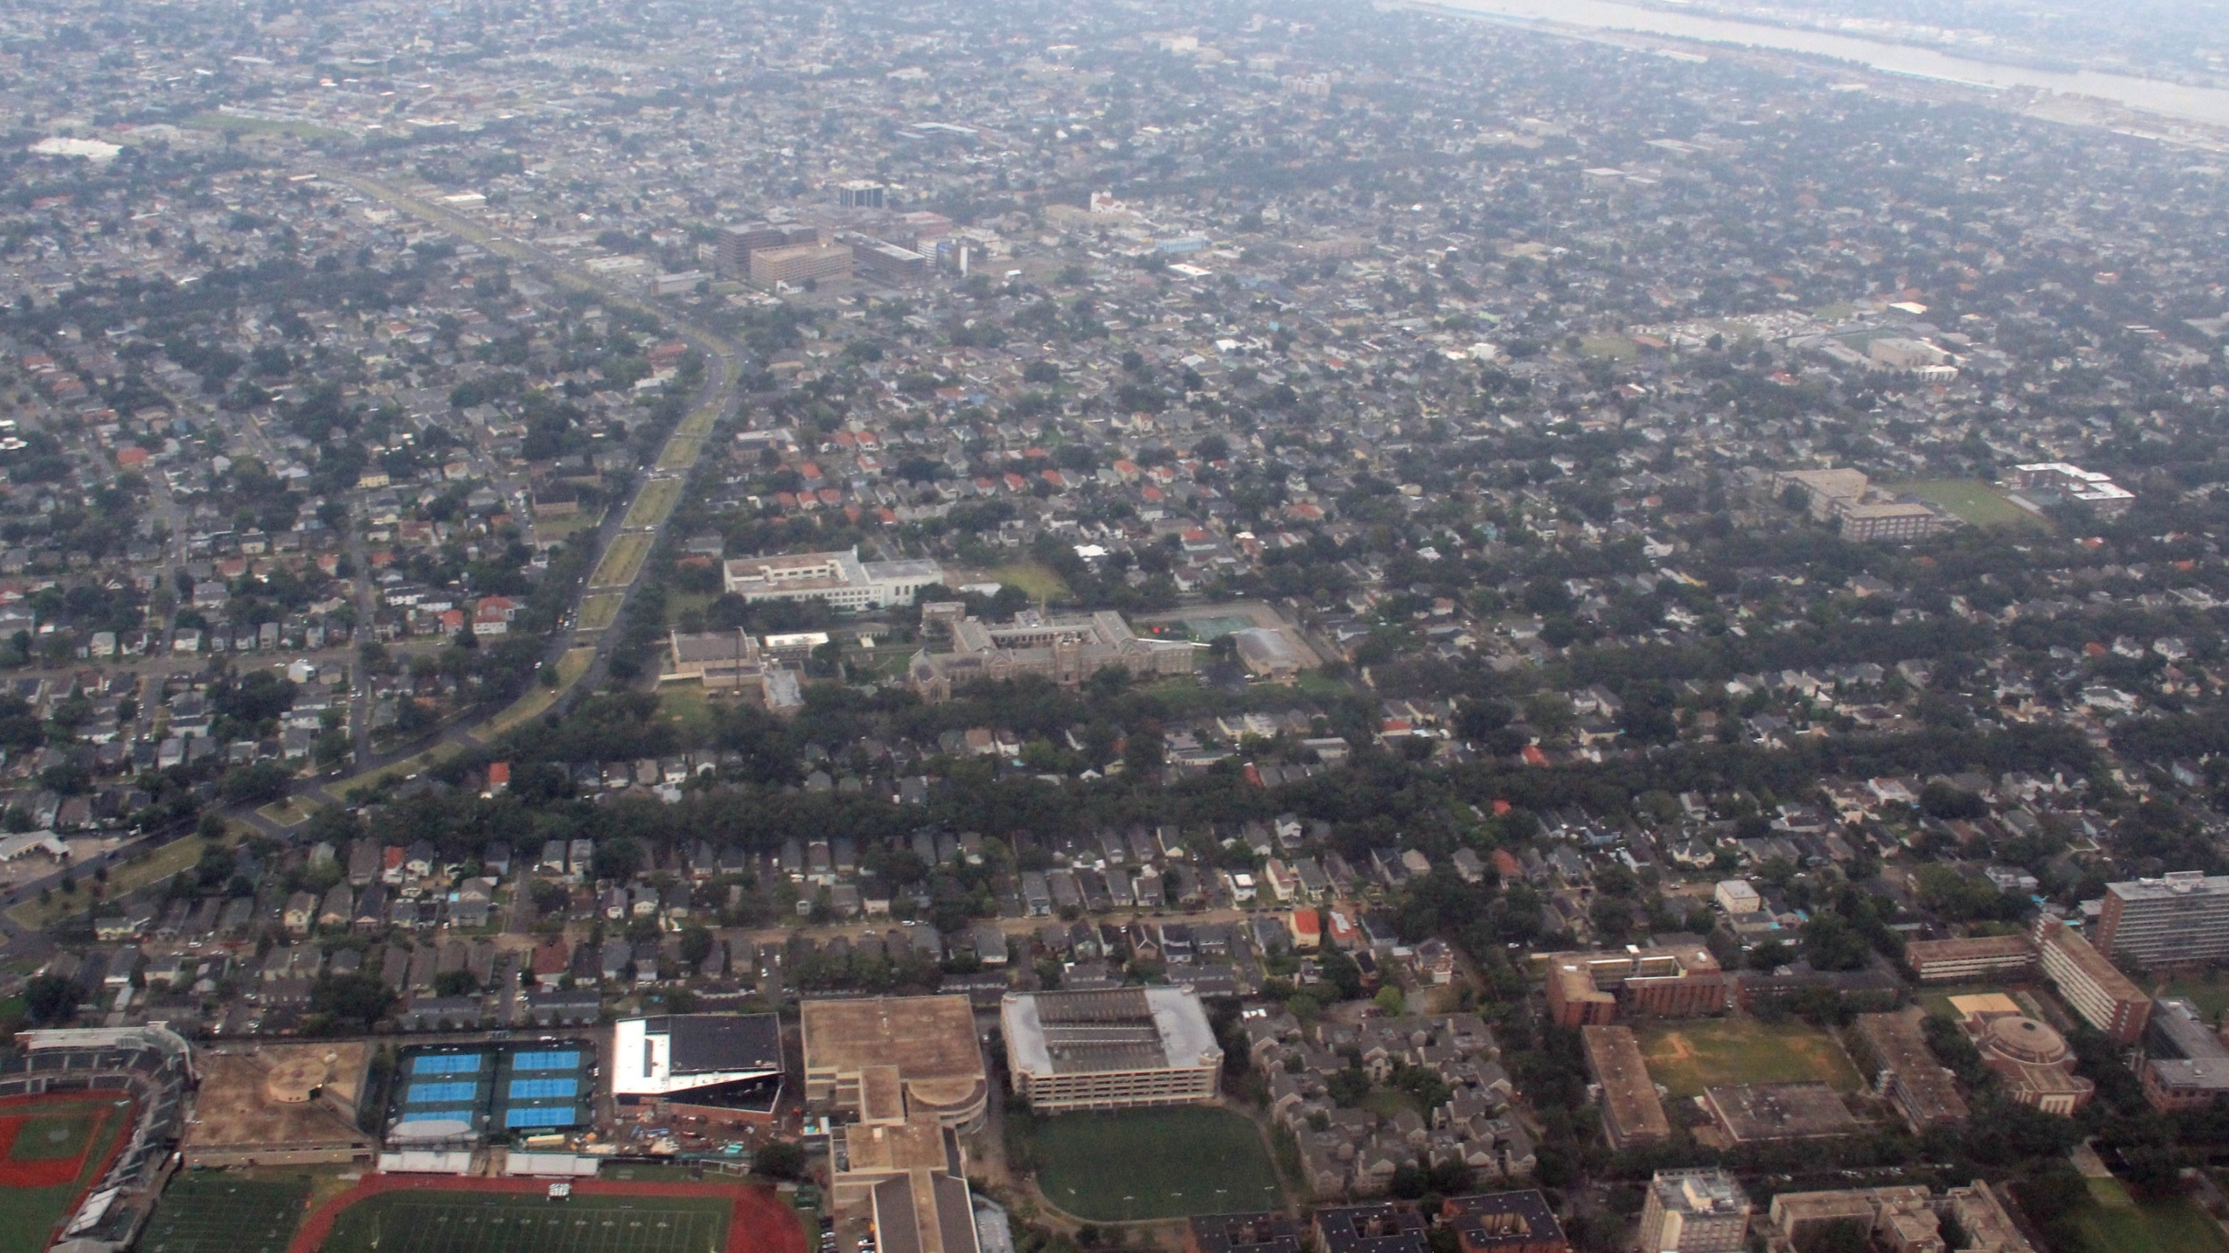
New Orleans Faces Many Economic and Environmental Problems
11.6ft
51%
PROJECTED NET SEA LEVEL RISE BY 2100
COST BURDENED RENTERS
27%
$10B
POVERTY LEVEL
LONG-TERM INFRASTRUCTURE NEEDS
Sources: The Data Center, Climate Action for a Resilient New Orleans
© THE FINANCE AUTHORITY OF NEW ORLEANS
7

Slide 8
In December 2017, FANO’s Board approved a new mission and strategic direction in response to social, climate, and economic challenges. Our vision for the future is a climate protected New Orleans with fair access to economic opportunity for all residents.
STRATEGIC VISION
© THE FINANCE AUTHORITY OF NEW ORLEANS
8

Slide 9
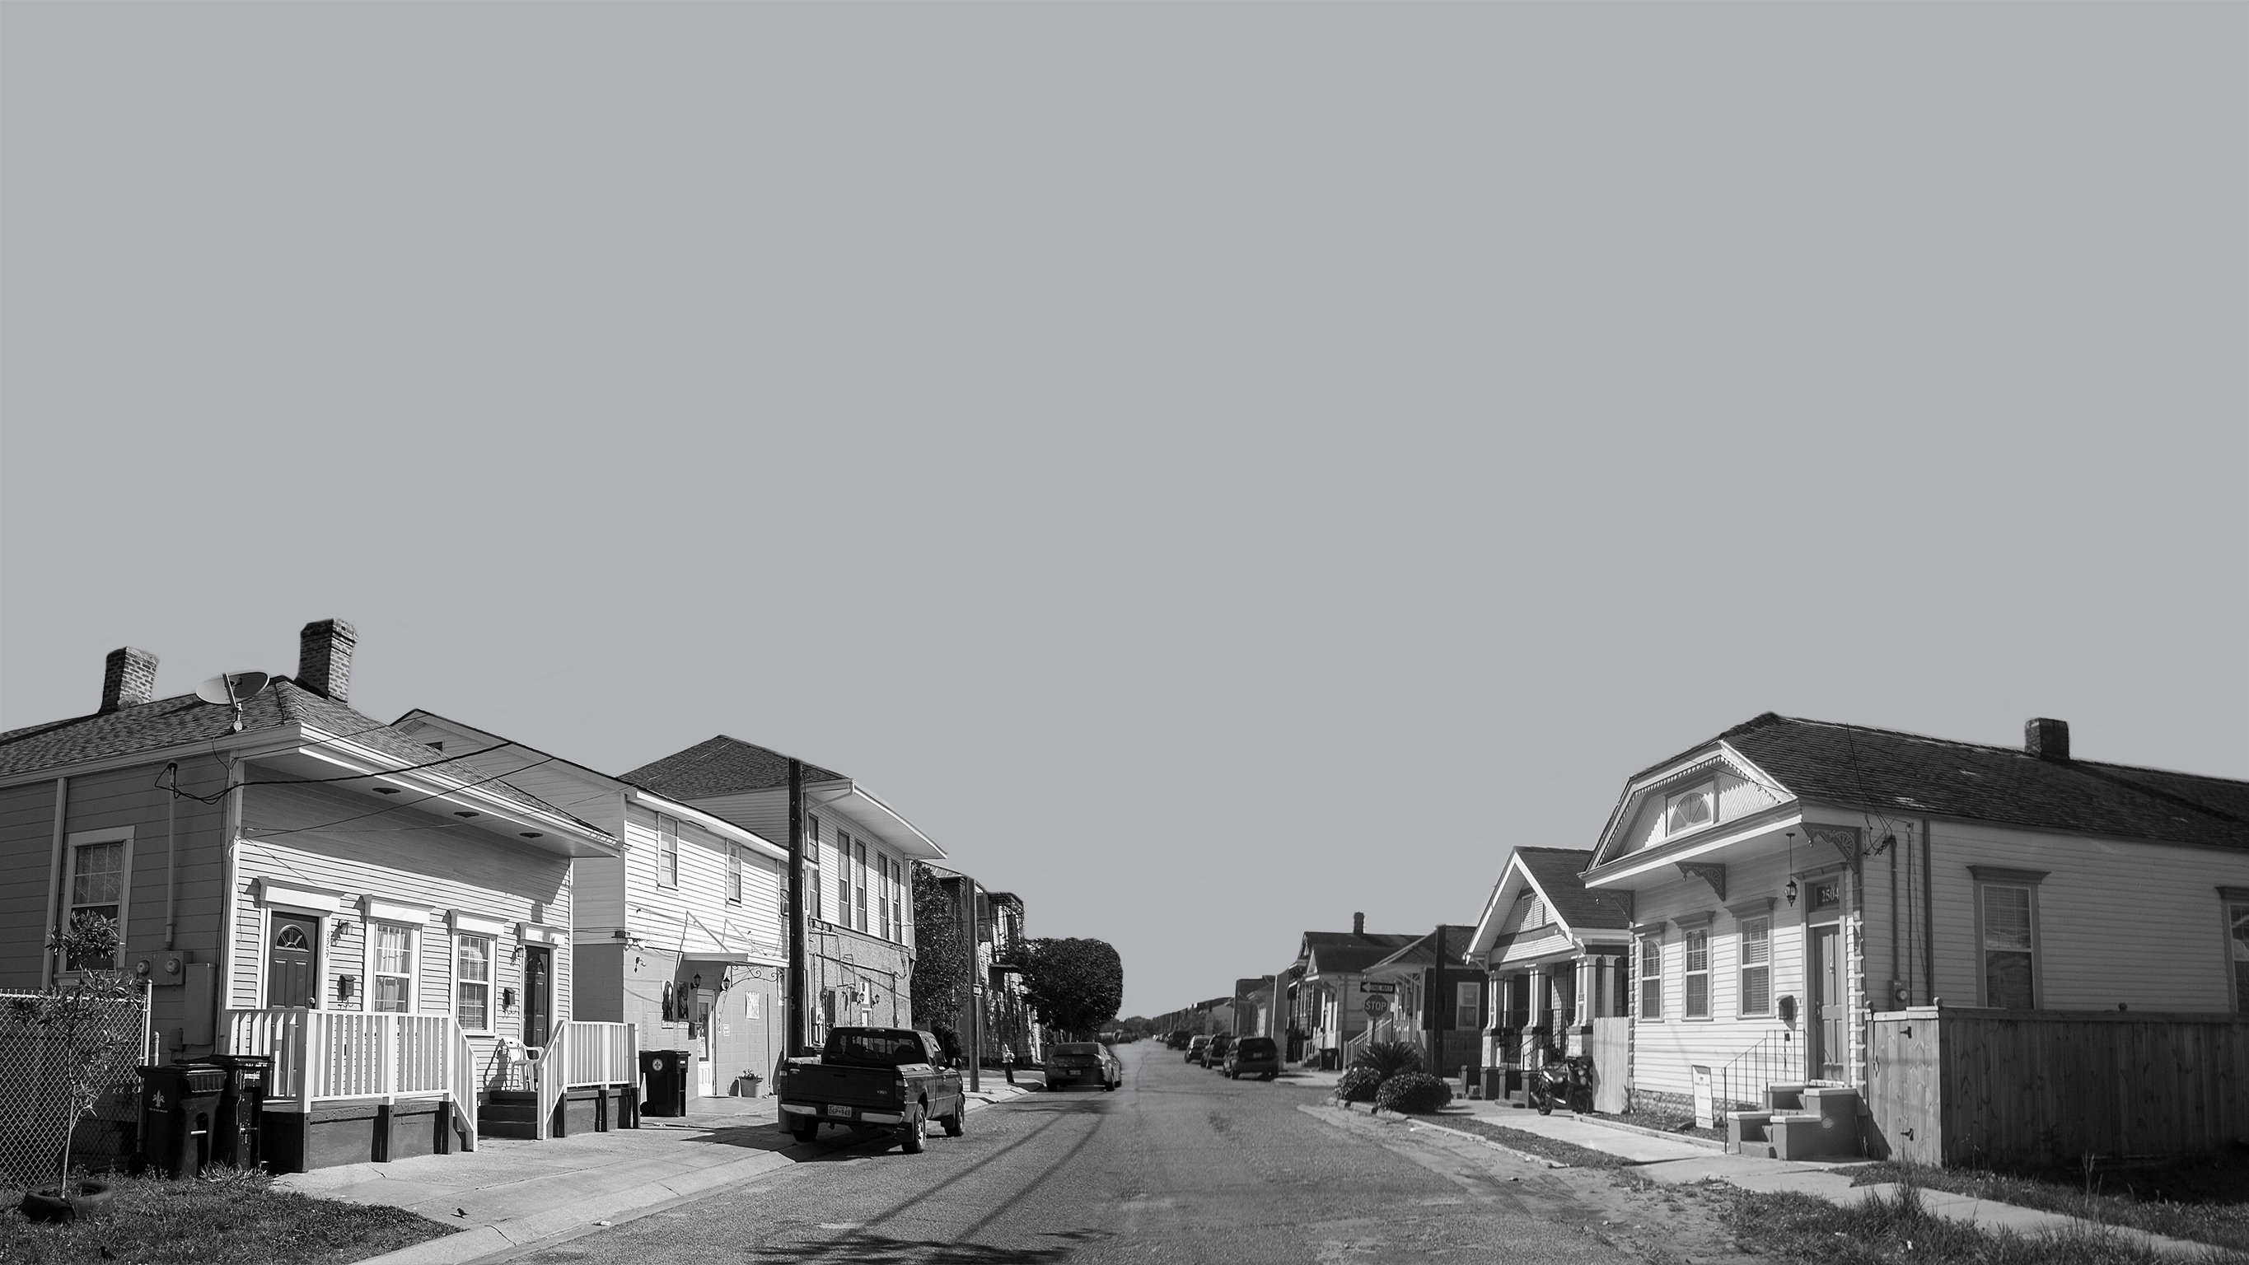
Local market demand for green and climate related financial solutions exceeds $5 billion
MULTIFAMILY
BUILDINGS
AFFORDABLE
HOMEOWNERSHIP
COMMERCIAL
BUILDINGS
GREEN/BLUE INFRASTRUCTURE
© THE FINANCE AUTHORITY OF NEW ORLEANS
9

Slide 10
Key Strategic ACTIONS (2019)
MODERNIZE operating infrastructure
ESTABLISH green finance/bond framework
RECAPITALIZE balance sheet
EDUCATE community on climate risks
LAUNCH green mortgage housing program
LAUNCH investor relations program

Slide 11
CITY OF NEW ORLEANS
KEY
PARTNERSHIPS
LOCAL HOUSING AGENCIES
COMMERCIAL BANKS
GREATER NEW ORLEANS FOUNDATION
CLEAN ENERGY FINANCING
ENTERGY NEW ORLEANS

Slide 12
MAKING NEW ORLEANS A BETTER HOME
FINANCEAUTHORITY.ORG
© THE FINANCE AUTHORITY OF NEW ORLEANS

