Slide 1
OUTLOOK FOR THE STATES
Municipal Analysts Group of New York
September 7, 2018
New York, New York
Scott Pattison, Executive Director and CEO

Slide 2


Slide 3
Key Issues
Health Care
Opioids
Innovation
Cybersecurity
Infrastructure
Education & School Safety

Slide 4
State Outlook
2018 elections: uncertainty & opportunities
Impact of Supreme Court decisions
Revenue growth up, but liabilities remain
Preparing for possible downturn

Slide 5

Political Climate
In 2018:
  33 Republican governors
  16 Democratic governors
  1 Independent governor
  18 new governors
  22 incumbents running for re-election
Notes:
9 new governors were elected on Election Day 2016.

Slide 6
Political Climate
State Government Control
  26 Republican-controlled governments
  8 Democratic-controlled governments
  21 state governments with divided control
Notes:
9 new governors were elected on Election Day 2016.

Slide 7
Toughest Issue
  Medicaid growth rates
  Medicaid expansion on ballot in Utah, Idaho, Nebraska & Montana
  Medicaid spending projected to grow 5.8% per year from 2017-2026 (Centers for Medicare & Medicaid Services)
Notes:
9 new governors were elected on Election Day 2016.

Slide 8
  Legislative Context
19 legislative days in U.S. House
35 legislative days in U.S. Senate
Key issues:
  Opioids
  Election Security
  Opportunity Zones
  Workforce
Notes:
9 new governors were elected on Election Day 2016.

Slide 9
States will be impacted by the
116th Congress
Infrastructure
Trade
Oversight & Investigations
Budget & Appropriations
Immigration
Higher Education Act Reauthorization
Workforce Development & Job Training
Health Care

Slide 10
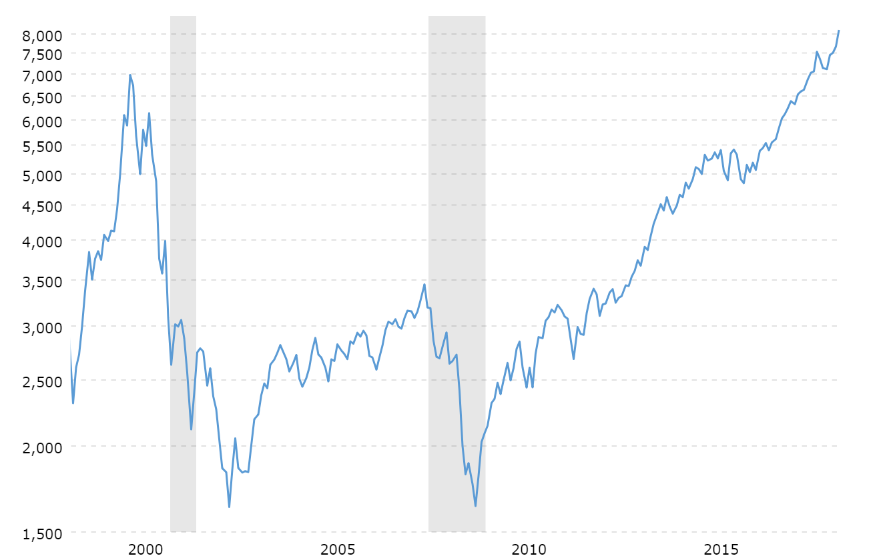
Economic Climate
Bullish Stock Market Performance
Macrotrends.net

Slide 11
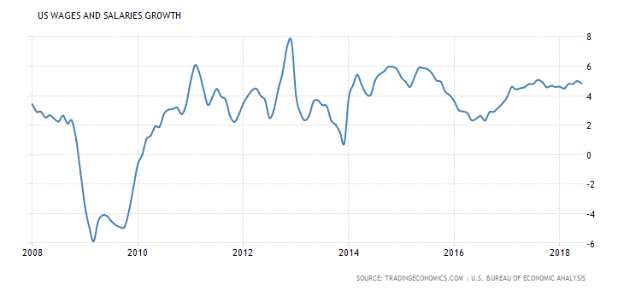
Economic Climate
Stagnant Wage Growth

Slide 12
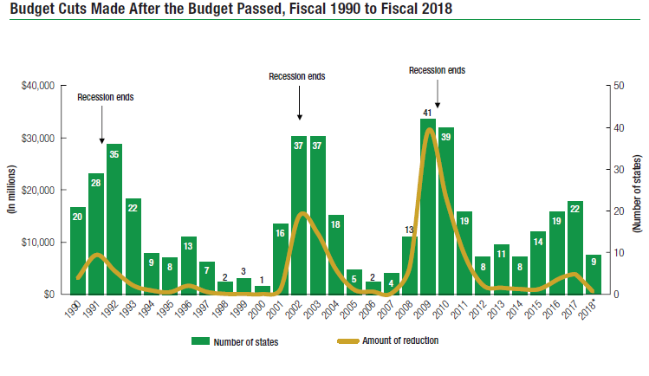
State Fiscal Climate
Fewer states are making budget cuts
NASBO – 2018 Fiscal Survey of States

Slide 13
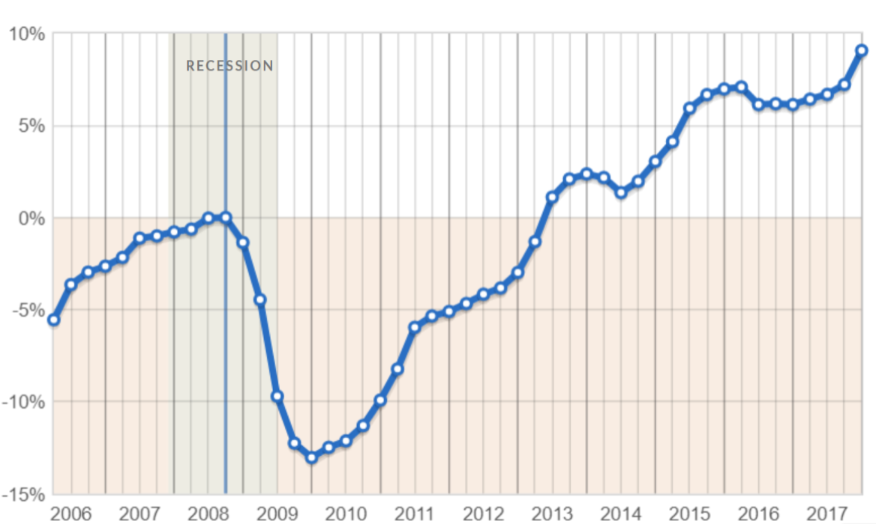
Fiscal Climate
Change in Tax Revenue
Change in Tax Revenue From Each 50 State’s Peak Quarter, Adjusted for Inflation, PEW

Slide 14
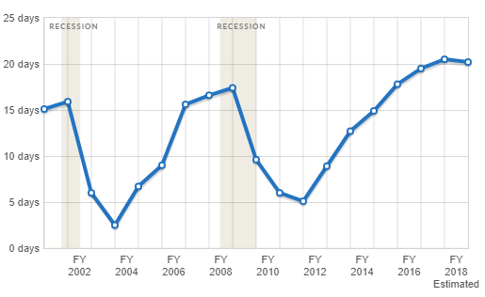
Fiscal Climate
States Plan Ahead: Days Each State Could Run on Rainy Day Funds

Slide 15
State Funds Expenditures by Function
Estimated Fiscal 2016

Slide 16
Total State Expenditures by Function
Estimated Fiscal 2016

Slide 17
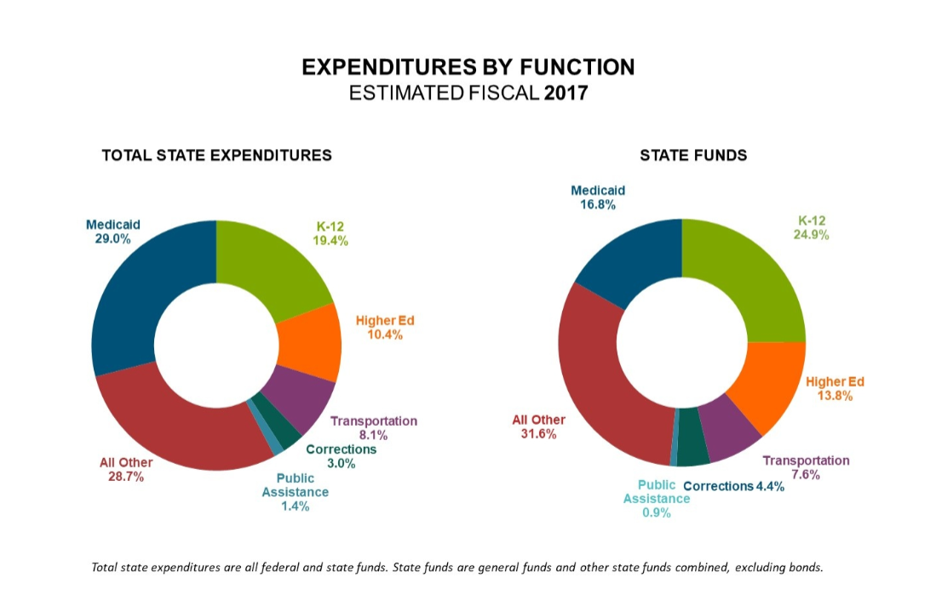
State Expenditures by Function
NASBO

Slide 18
Municipal Bonds
$2 trillion infrastructure spending gap
Critical for state and local infrastructure projects
Safe and reliable
Discussions of capping or excluding
No vibrant replacement

Slide 19
Municipal Bonds
State & local governments fund 75% of all U.S. infrastructure projects
P3s account for only 1.5% of infrastructure funding (MSRB)
Tax exempt financing a critical issue for state governments

Slide 20
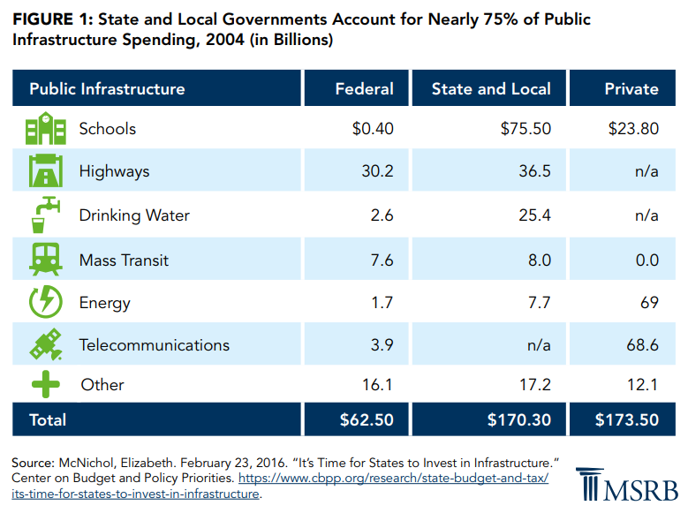
Municipal Bonds

Slide 21
Municipal Bonds and NGA Policy
Current tax policies on muni bonds = infrastructure
Clear communication between state and federal partners is critical

Slide 22
Tools for Financing Infrastructure
Muni Bonds
Infrastructure Bank(s)
Public Private Partnerships
Federal Credit Assistance Programs

Slide 23


Slide 24
OUTLOOK

Slide 25
State Outlook
Federal government impacts
Deferred infrastructure maintenance, long-term liabilities
Uncertainty about economy, federal government

Slide 26
Questions/Discussion
Scott Pattison, Executive Director and CEO
spattison@nga.org

