Slide 1
Demographic transition and its effect on longer-run growth and interest rates
Satyam Panday, Ph.D.
Senior Economist
Global Economics and Research
June 8, 2018
Copyright © 2018 by S&P Global.
All rights reserved.

Slide 2
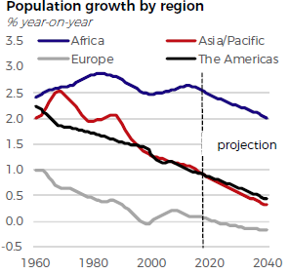
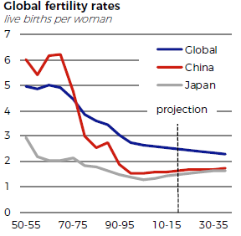
Global Population Growth is Slowing and Will do so through mid-century

Slide 3
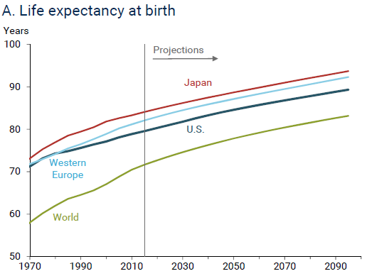
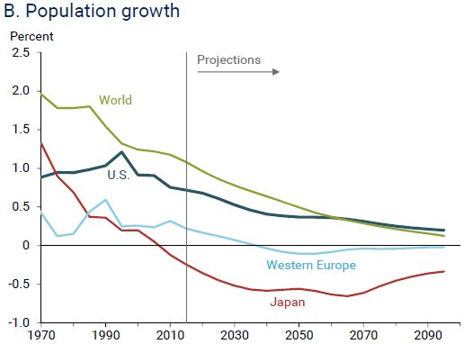
Population growth rates are declining and, in some cases, even become negative

Slide 4
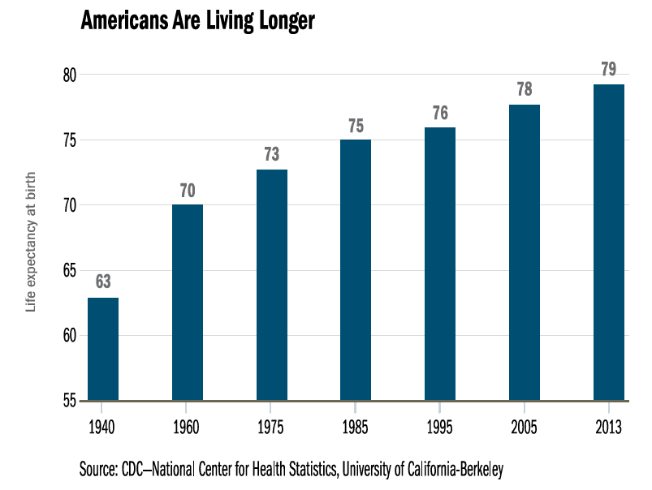

Slide 5
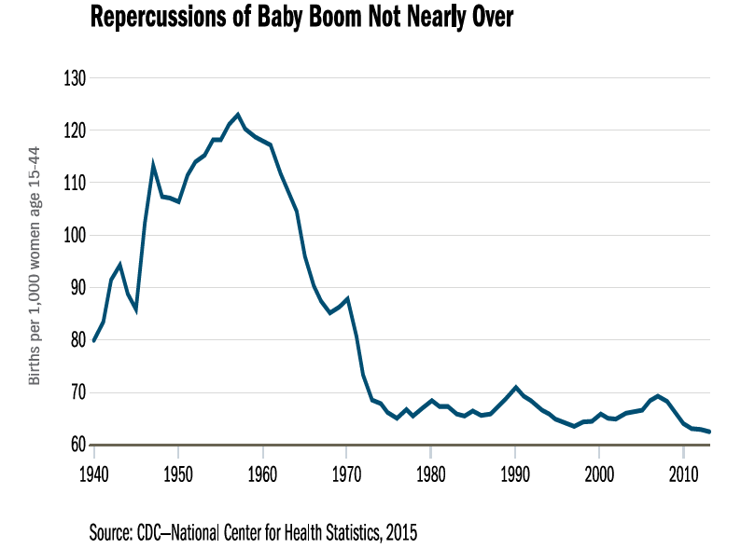

Slide 6
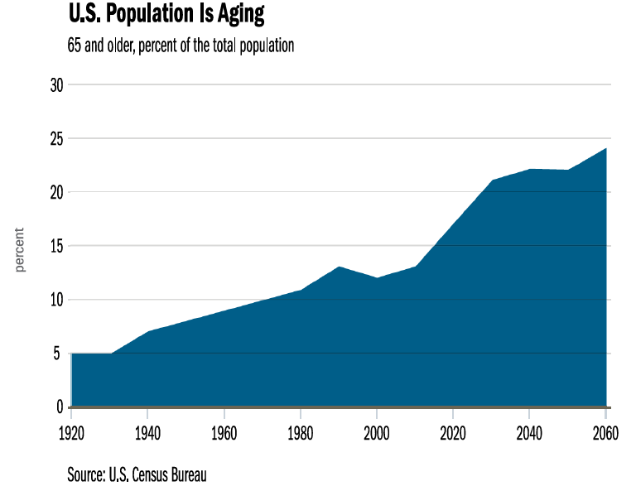
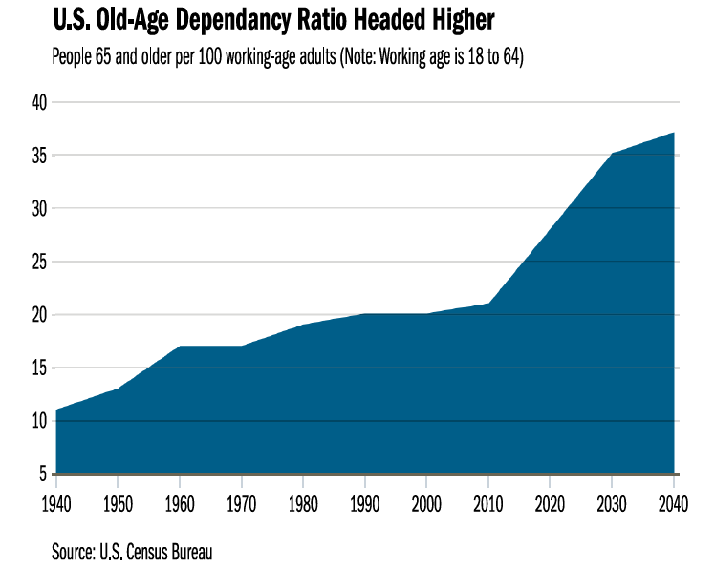

Slide 8
Implications for growth
Absent a renewed pick-up in productivity growth (such as we saw from 1994 through 2004), growth is thus likely to remain a notch slower.
Demographic Decomposition of GDP Growth
 | Average per year Contribution to Real GDP Growth(percentage points)
 | (1) | (2) | (3) | (4) | (5)
 | population | labor force participation | population dynamics (1+2) | laborforce productivity | GDP (3+4)
1994-2004 | 1.35 | -0.09 | 1.26 | 2.40 | 3.66
2004-2014 | 1.10 | -0.47 | 0.63 | 1.00 | 1.63
2014-2024 (proj) | 0.80 | -0.32 | 0.48 | 1.70 | 2.18
Source: BLS, Census Bureau, S&P Calculations
Notes:
(1) civilian working age population (16 years and over)
(2) labor force is number of people working or looking for jobs; labor force participation rate is labor force as a share of working age pop.
(3) equals sum of (1) and (2), giving the contribution to growth directly from population dynamics
(4) GDP/number of workers in the labor force
(5) equals sum of (3) and (4)
(proj) projections for population and labor force are from the BLS. Labor force productivity is projected to be a little more than the average of past 20 years.

Slide 9
The U.S. economy appears to be at potential…
Evolution of output gap (the gap between potential GDP and actual GDP)
…But the potential is a notch lower due to slow down in productivity growth and growth in labor force.

Slide 10
Demographic transition has put significant downward pressure on interest rates
Basis Points | Estimates of size of fall in R* and factors behind it
 | (1980-2015)
 | Rachel and Smith (2015) | Holston et al. (2016) | Gagnon et al. (2015)
 | Global | U.S. | U.S.
Potential Growth | -100 | -170
Other Factors | -350 | -130
Demographics | -90 |  | -125
Inequality | -45
Savings Glut | -25
Fall in prices of capital goods | -50
Lower public spending | -20
Rise in Spreads | -70
Other | -50
Note: Holston, Laubach and Williams (2016) estimate a drop of around 300bps for the US while Rachel and Smith (2015) estimate a drop of 450 bps for global R*. Gagnon, Johansoon and Lopez-Salido (2015) argue for a smaller decline for the US of about 125 bps since the 1980s, on the basis that real interest rates were very high in the early 1980s, well above R*.

Slide 11
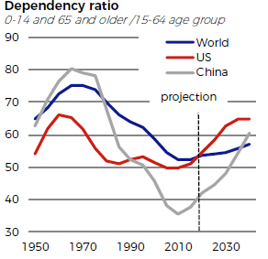
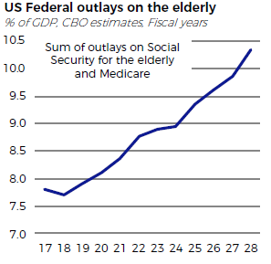
The combined influences from (1) savings being drawn down and (2) increased Federal outlays for care of the elderly pushes up the equilibrium real interest rate into the next decade or so, which could potentially offset any effects in the other direction resulting from lower population and, thus, real GDP growth.

