Slide 1
The Next Recession:
What to Expect
The Municipal Analysts Group of New York
The Yale Club of New York City
50 Vanderbilt Ave., New York, NY
June 8, 2018
Don Boyd
Senior Research Fellow, Center for Policy Research
Rockefeller College, University at Albany, SUNY
donboyd5@gmail.com

Slide 2
Recessions and
State & local government finances
Two kinds of responses:
“Automatic” responses (e.g., tax revenue declines)
Policy responses (e.g., cuts in school aid – fiscal stress rolls downhill)
Responses roll out over time. A dynamic, multi-year process.
Not always practical to separate automatic responses from policy responses (e.g., property tax rate increases can offset property value declines).

Slide 3
Automatic responses
Tax revenue. Three main considerations:
Nature of the recession
Structure of the state or local economy
Structure of the state or local tax system
Spending. Automatic responses usually are smaller than tax revenue responses. Two important ones are:
Medicaid – people become unemployed, lose health coverage; with a lag, many eligible for Medicaid, enrollment rises
Pension contributions (we might also think of this as policy response)
Policy responses by one level of government can be exogenous factor for another – e.g., cuts in state aid to schools.

Slide 4
Recessions vary greatly. Implications for “automatic” impacts on governments.

Slide 5
Recession impacts vary geographically…

Slide 6
…in part because state economies vary greatly

Slide 7
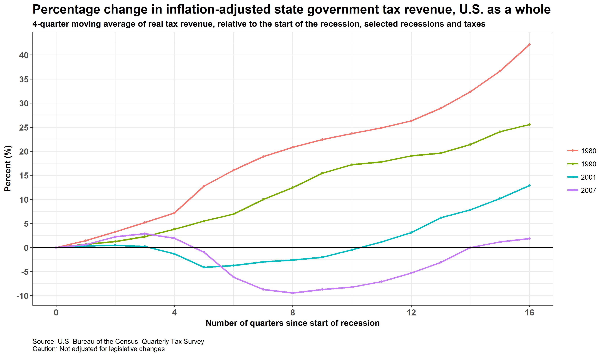
Different recessions, different impacts

Slide 8
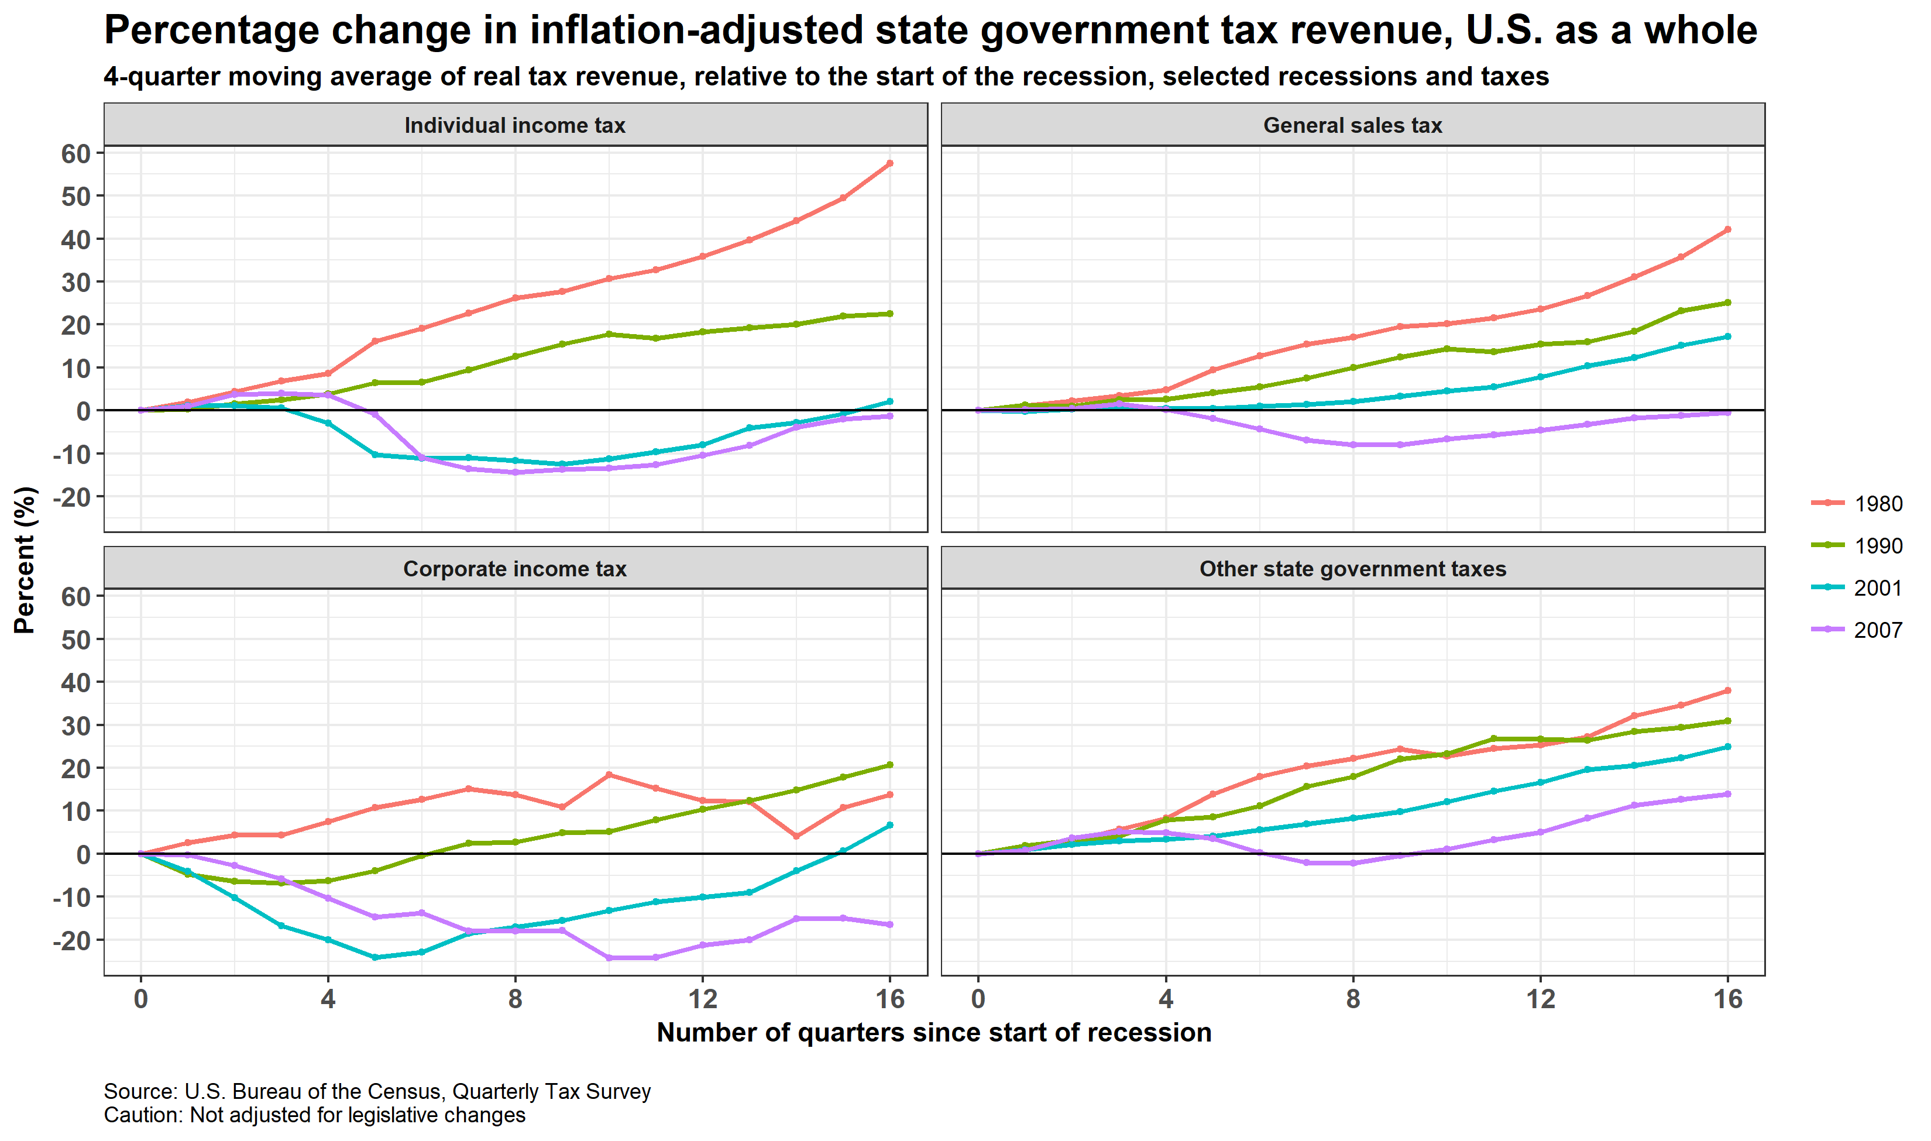
Different taxes & recessions, different impacts
2001 and 2007 hit the income tax

Slide 9
Taxable income more volatile than economic income measures
Compare!

Slide 10
Capital gains significance

Slide 11
Capital gains - hot money, moves quickly on decisions by a relative few. 0.3% of tax returns had 62% of all capital gains

Slide 12
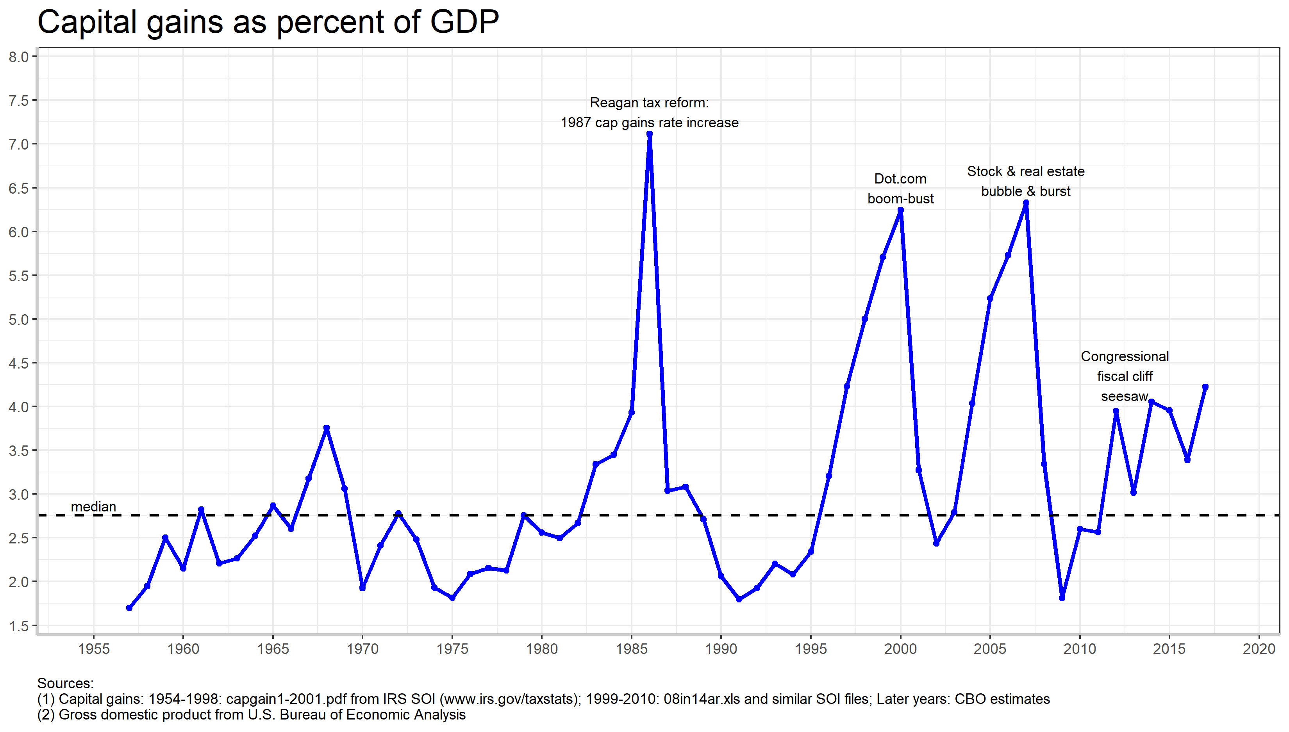
Recent capital gains run-up much smaller than run-ups before last 2 recessions. Next collapse, if any, probably smaller.

Slide 13
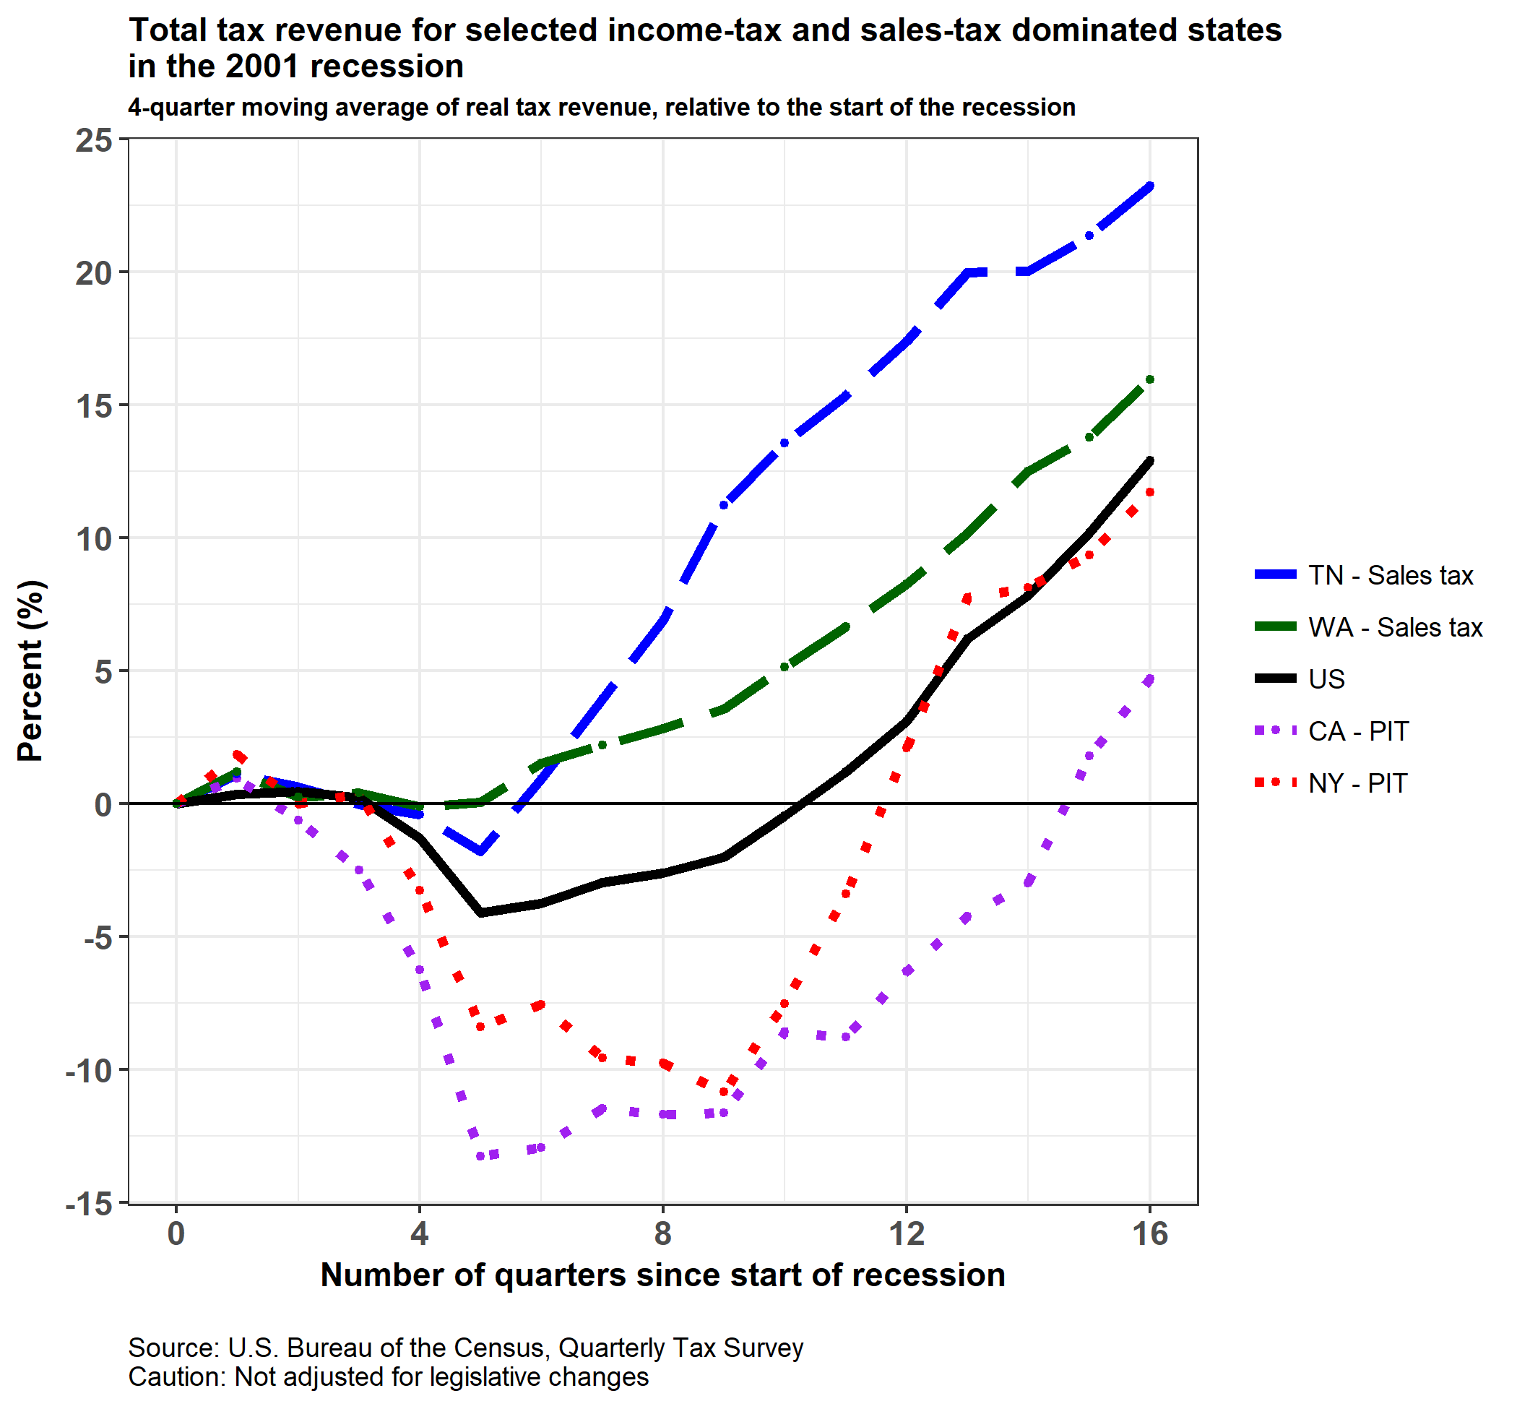
Tax structure really mattered in the 2001 recession: Large financial market declines, minor consumption impact

Slide 14
The property tax and recessions
In contrast to property tax, income and sales tax “automatic” responses are simple:
    economic changes → tax base changes → tax collection changes
  with some lags.
Property tax mechanisms are more complicated:
  Economic changes → property market value changes? How much? Often not large (2007 recession excepted).
  Market value changes → assessed value changes? When? 1 year, 3 years, 5 years? E.g. CA Prop. 8
  Assessed value changes → taxable assessed value changes? All at once? Phased in over years? Limits on individual-property increases (e.g., homeowners)? No large increases until sold?
  Taxable assessed value changes → tax levy changes (policy response)? Can gov’t increase tax rates to offset assessed value declines? Are tax rates or increases capped? Is levy capped? E.g., CA Prop 13
Hard to separate “automatic” response from policy response.
Can be big revenue reductions (e.g., CA, last recession), or offsetting rate increases (e.g., much of NJ, NY last recession).
Can take years to play out.
Property tax generally much stabler than income and sales taxes, in part because of assessment lags and constraints, in part because policy response (tax rate increases) can occur right away.

Slide 15
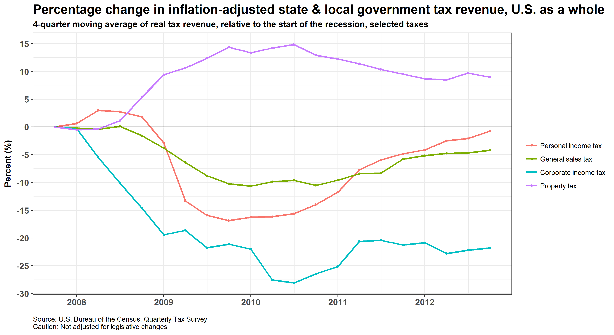
Despite the housing bust, the property tax held up in latest recession compared to other taxes (U.S. averages)

Slide 16
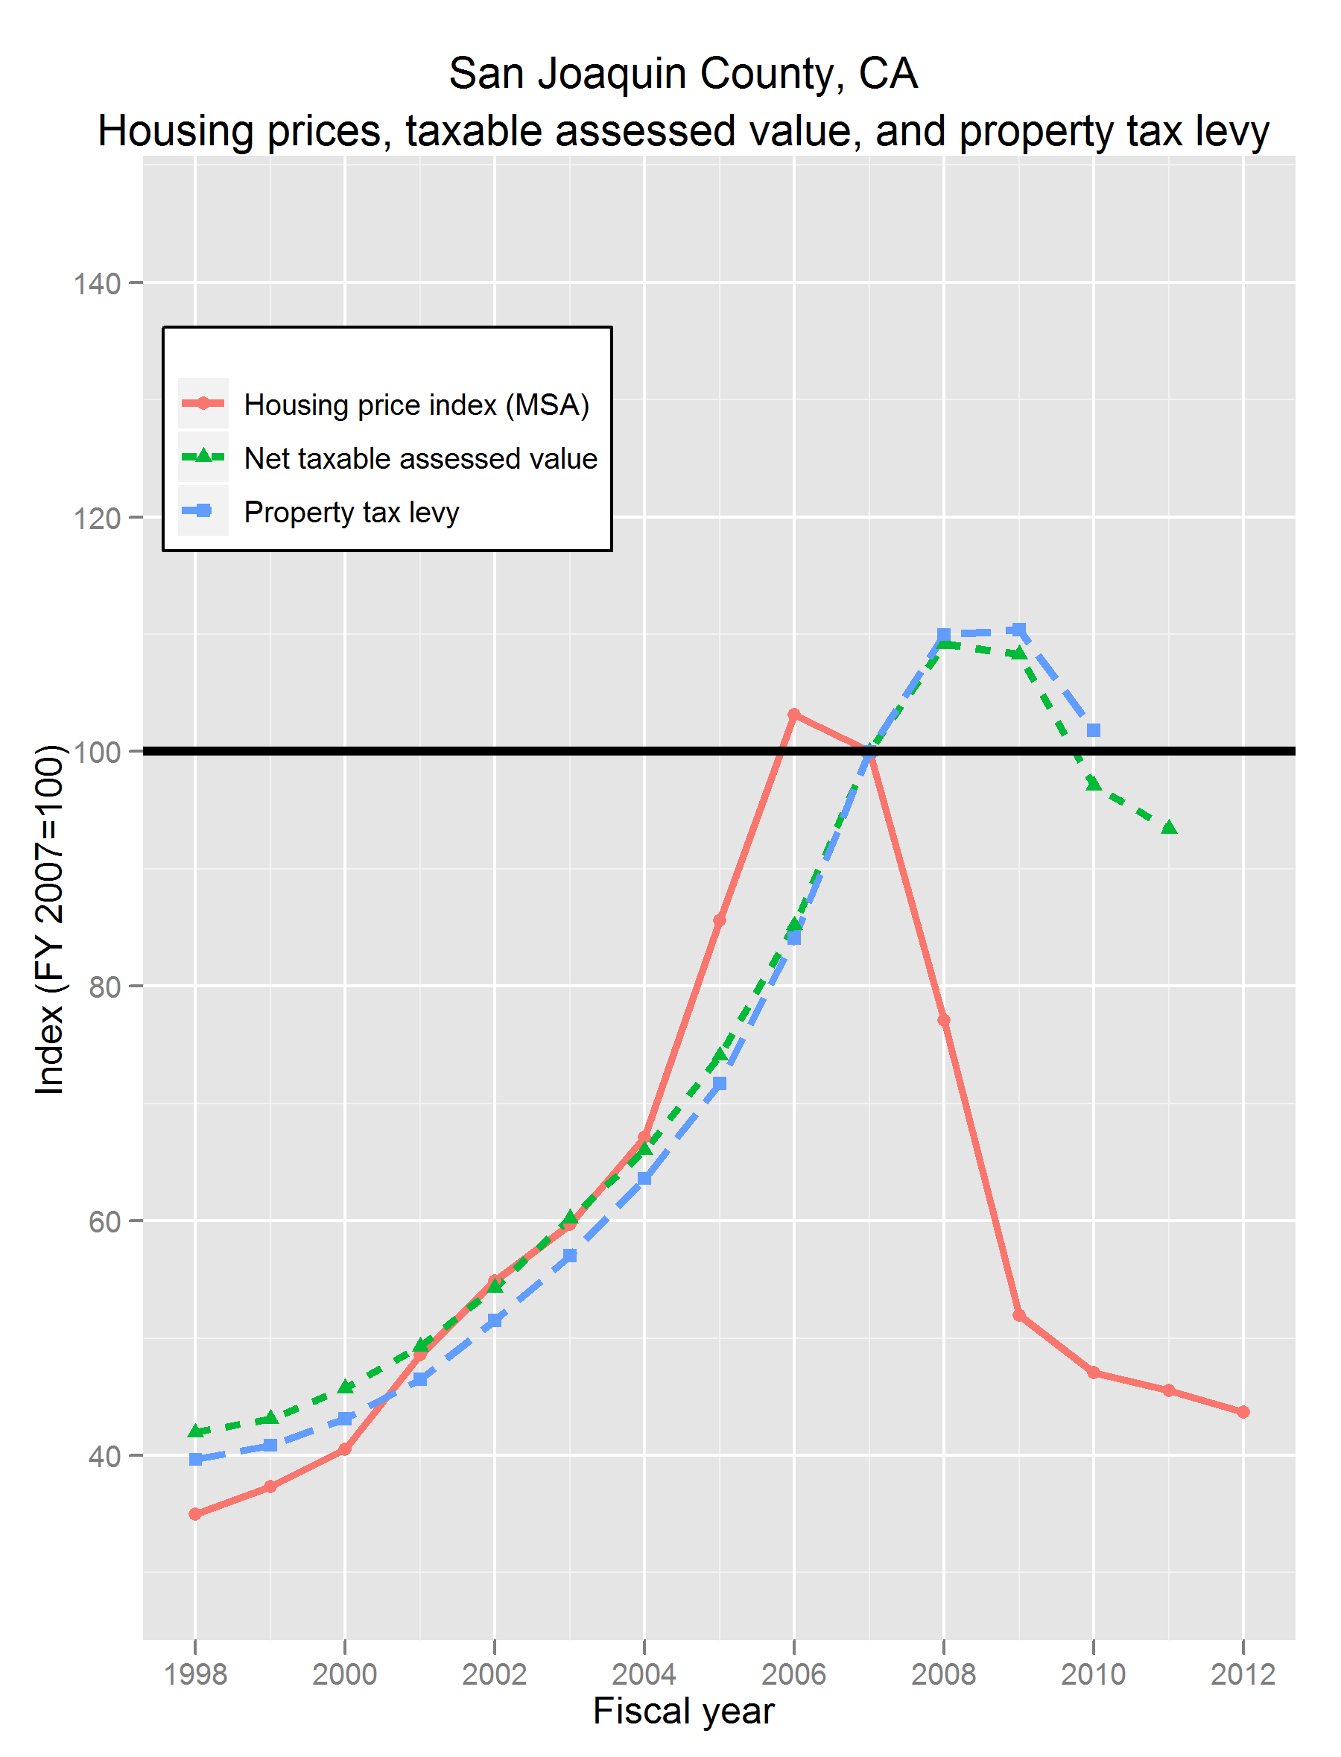
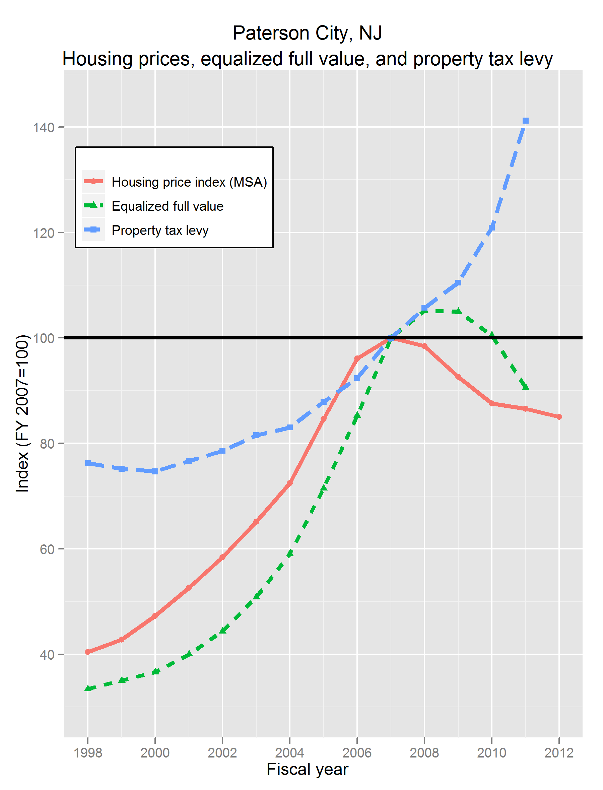
A tale of two governments: Property tax rules matter, location matters

Slide 17
Pensions and recessions
Some recessions have hit asset values hard (1973, 2001, 2007), and some have not. (See earlier table.)
Potential size of shortfalls relative to budgets – i.e., risks – much larger now than in 1980s and 1990s
Investment-return shortfalls drive contributions up with a lag. Magnitudes and lags depend upon:
  Cost methods (how actuaries attribute pension costs to different time periods)
  Funding methods (asset smoothing, amortization period and method). Many plans use methods that stretch payments out.
  Whether the government pays what actuary calculates!

Slide 18
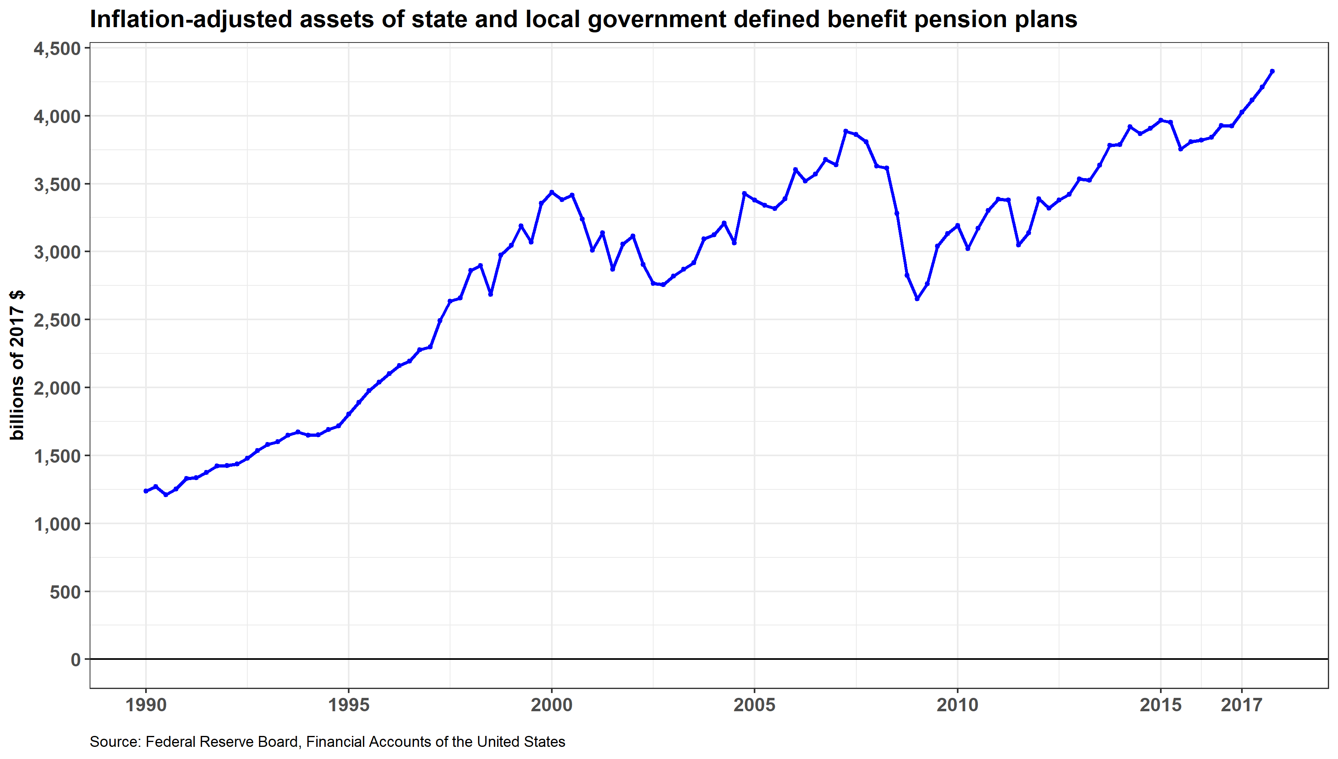
Public pension funds: $4.3+ trillion assets; > 2/3 in equity-like investments; risk larger relative to budgets than ever
-20%
-32%
-5%

Slide 19
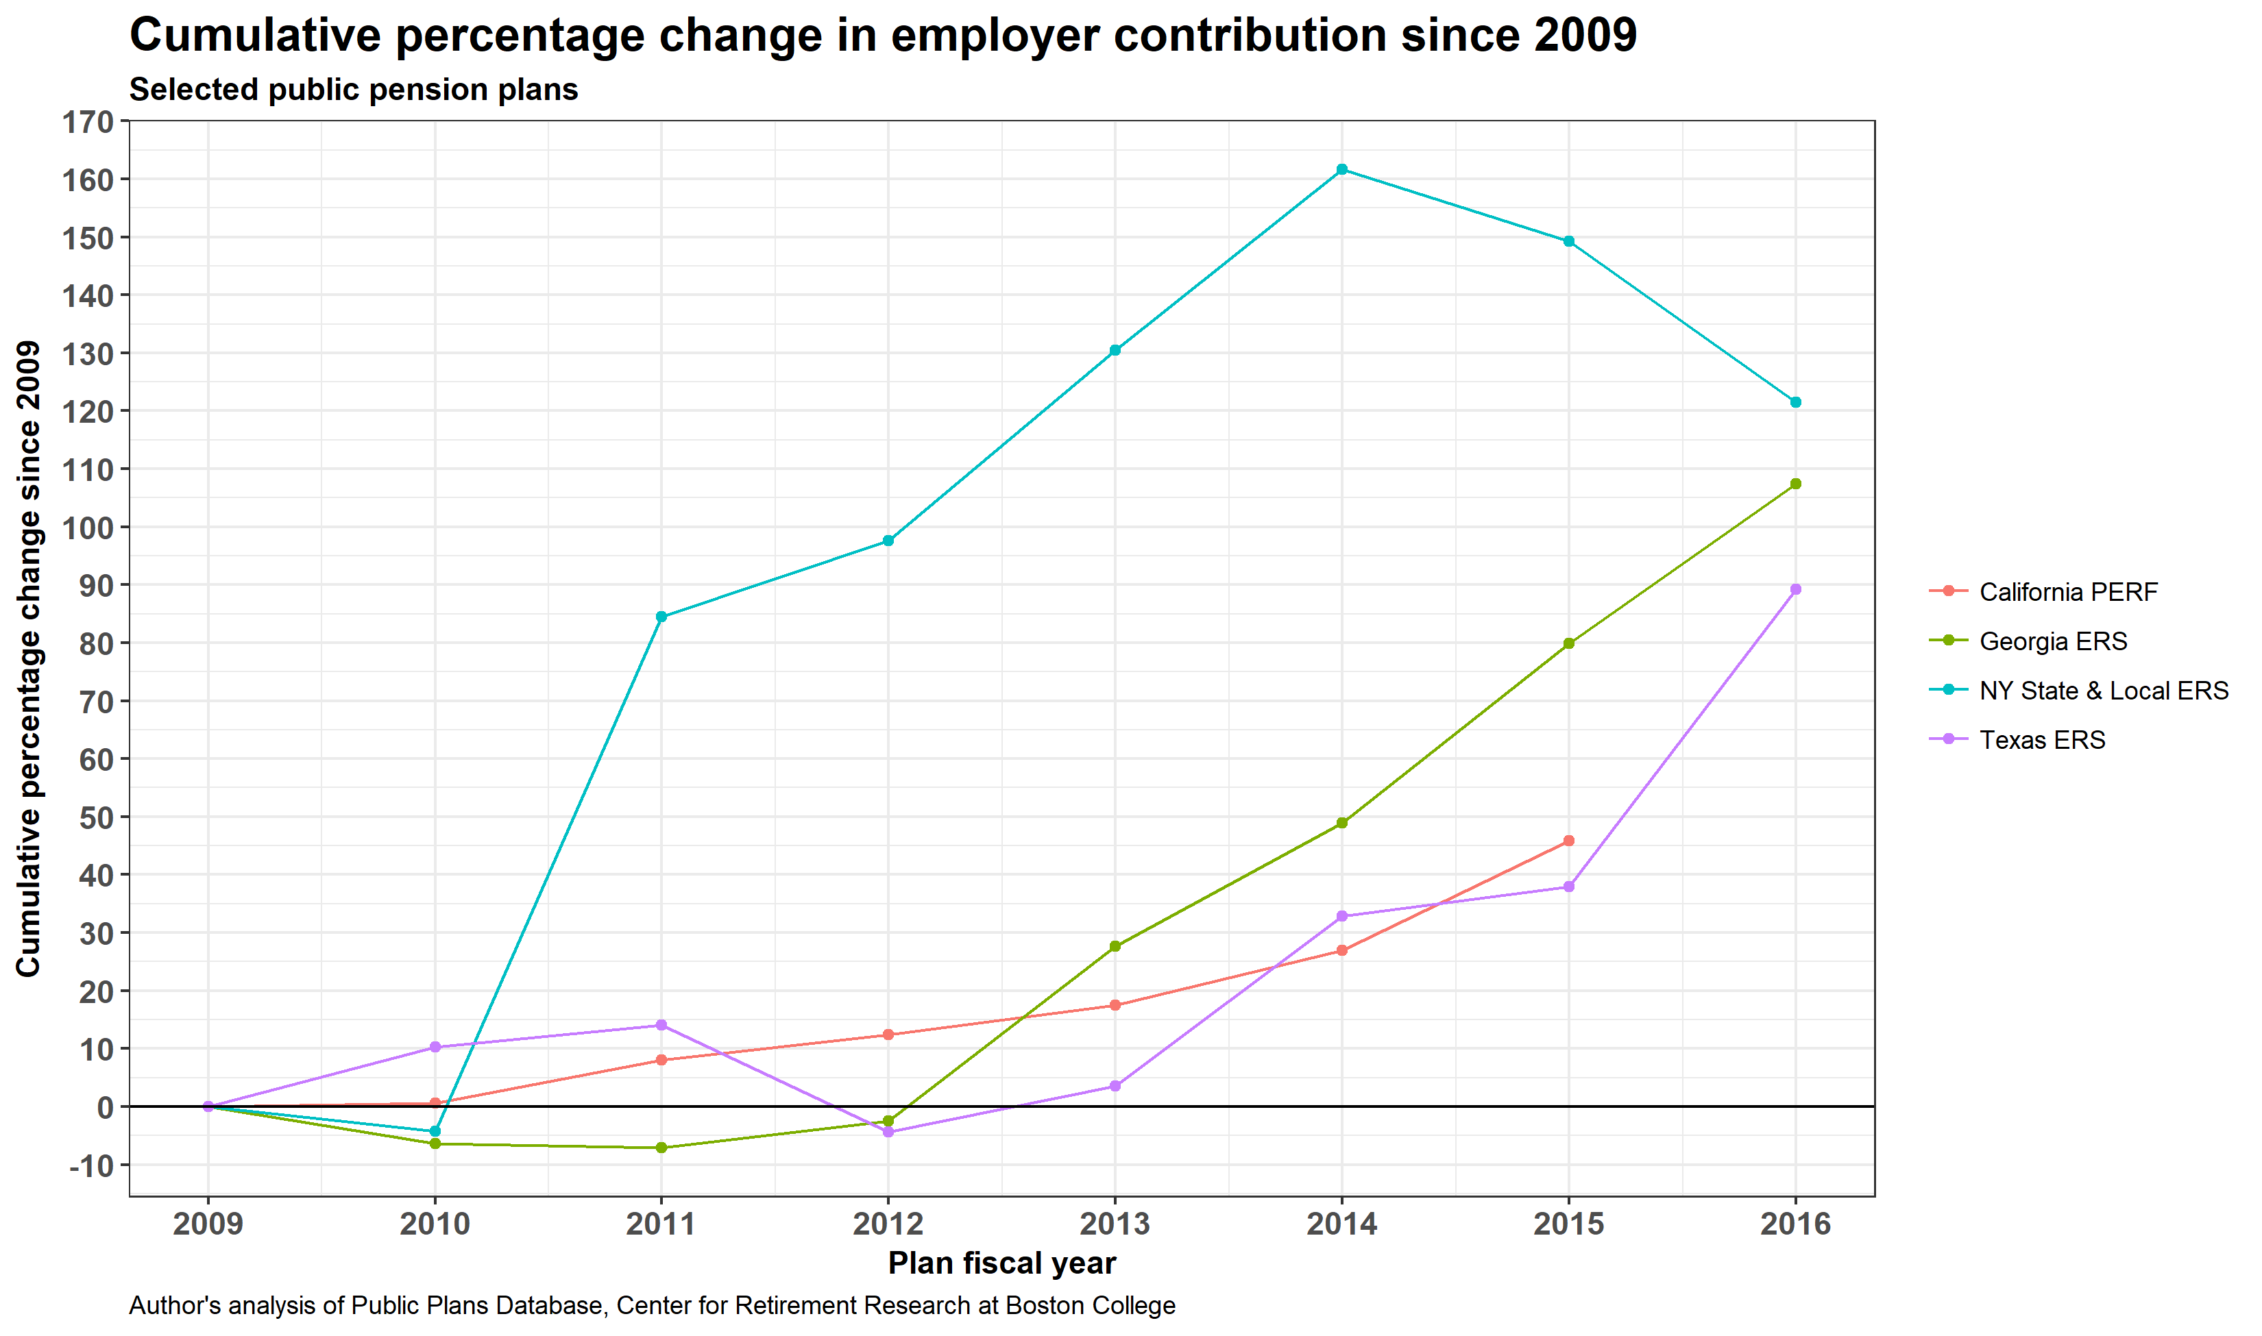
Pension contributions respond with lags and magnitudes that depend heavily on (1) recession impact on asset values, and (2) plan and government policies, practices, and circumstances

Slide 20
Thoughts on magnitudes, in round numbers
State govt taxes: ~$1 tr. annual
  IF 10% below trend for 2 years (pretty bad)
  ~ $200b of “lost” revenue
Medicaid: ~$250b state-local share, annual
  IF 8% above trend (big enrollment surge), 2 years
  → ~ $40b unplanned spending
Pensions: $4.3 tr. assets:
  IF 10% decline over 2 years, and 7% was assumed for each year
  → ~ $1.1 tr. shortfall vs assumed (math: $4.3 * 1.07^2 – $4.3 * .90%)
  even amortized over 20+ years, that is a lot (better hope for mean reversion in asset returns – better still, hope for non-financial recession)

Slide 21
Dynamic nature of impacts and responses
First, revenue (and spending) must be affected:
  Sales taxes – almost right away; excises, too, to extent responsive.
  Income taxes: (1) Withholding on wages hit almost right away. WH on bonuses primarily affected in Q4 and Q1; can be big, esp. in financial sector. (2) Nonwage income - payments heavily concentrated in Dec/Jan and subsequent Apr/May.
  Pensions, Medicaid – long lags
Second, policymakers must recognize problem & come to grips with it. Can take months, esp. if legislative body not in session. Layoffs take time to implement. Secondary impacts on local govts (e.g., school aid cuts can take a year or more).
Political dynamics often favor easier choices – one-shots, gimmicks - setting govts up for problems in future years.

Slide 22
A few considerations re: next recession
How prepared are states, localities? Many places have not rebuilt reserves, are struggling with pensions. Picture is mixed.
Recent strong state tax revenue growth sending mixed signals (Strong 2017 stock market suggests strong cap gains; But taxpayers had incentives to push income out of 2017 into 2018 AND accelerate tax payments into 2017!; Surge in 2017q4 suggests acceleration of tax payments; but April returns were strong)
Will next recession hit financial markets hard?
  Heightens risks. Fortunately, capital gains less bubbly than prior to either of last 2 recessions – not as far to fall.
  But pension assets riskier than ever relative to state budgets
Medicaid
  Fed govt shares in the costs of enrollment increases
  But “extra” sharing of 2007 recession (ARRA) seems unlikely to repeat

