Slide 1
MAGNY: ESG, SRI and Green Bonds
May 11, 2018

Slide 2
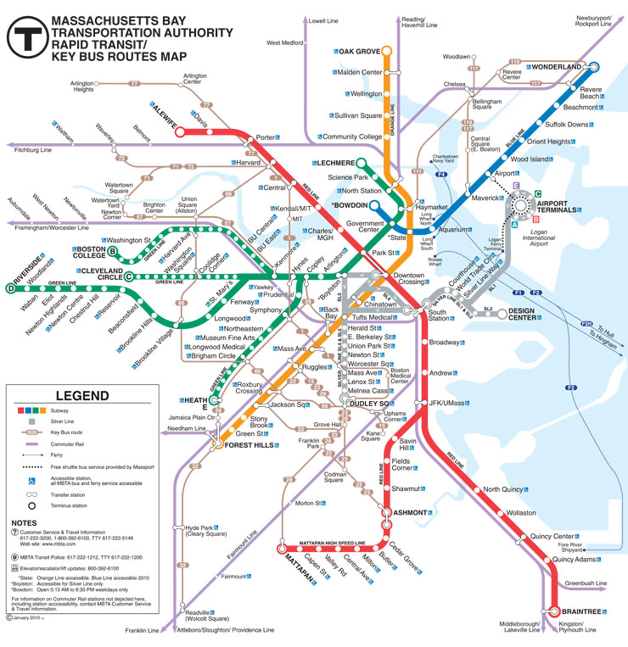
MBTA System Overview
The MBTA is the oldest and fifth largest transit system in the country providing extensive and integrated mass transit services along with parking facilities for the greater Boston metropolitan region.
Territorial area throughout eastern Massachusetts consists of:
175 cities and towns
4.8 million population
MBTA Transit System consists of:
Rapid transit rail, streetcars and light rail and more than 1,000 buses
Commuter rail service operates over 421 units of passenger rail equipment providing service between Boston and 131 outlying rail stations
Other passenger services, including commuter boats, “The Ride” paratransit service, and express buses
1.3 million passenger trips on average per business day; 55% of all trips to Boston are provided by public transportation
Approximately 5,900 employees; $2B operating budget

Slide 3
Capital Investment Plan (CIP)
MBTA's Capital Investment Program (CIP) is a rolling five-year plan, which outlines current infrastructure needs and details planned investments.
FY18-22 CIP Spending by Priority ($M)

Slide 4
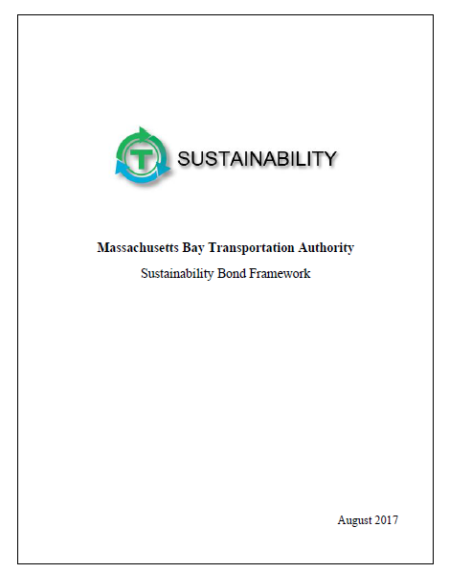
Sustainability Bonds
MBTA sold the first ever tax-exempt Sustainability Bonds in October 2017. The innovative offering set precedents for both municipal and ESG markets.
Deal recognized as The Bond Buyer’s 2017 Northeast Region Deal of the Year
Proceeds from Sustainability Bonds fund projects which have distinct social and/or environmental benefits.
Sustainability Bond Framework incorporates feedback from MBTA departments as well as guidance from investor groups and the academic community.
$100M of the Sales Tax Bonds and the full $233M of Sales Tax Bond Anticipation Notes have been identified as supporting sustainable projects.
Sustainability Bonds met the strongest investor demand.
9 banks participated in the sustainable offering
8 banks participated in the traditional offering
Of the 8 banks that participated in both offerings, 6 offered stronger bids on the sustainable series than the traditional series.
MBTA achieved a lower interest cost on Sustainability Bonds than comparable traditional bonds

Slide 5
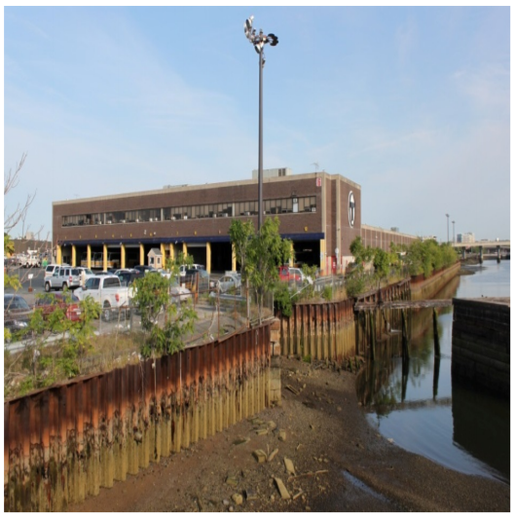
Sustainability Project - Charlestown Seawall (Climate Resiliency)
The Charlestown Seawall project protects a critical bus facility from increasingly worse storms, prevents scour and erosion, and minimizes runoff. Estimated Project Cost: $50M.
Approximately 8% of publicly owned seawalls in Massachusetts are in need of moderate to immediate repair. The assessed cost of repairs is in excess of $600M. The MBTA is pleased to make a contribution to the effort.
The Program
Rebuild a dilapidated retaining wall, beyond its useful lifespan, with modern drainage and additional utility specifications
The Objective
Prevent erosion at the MBTA’s largest bus-maintenance facility and ensure that the site remains stable and completely functional, while also protecting habitat and water quality along the Mystic River
What’s Next
Ensure that MBTA assets are climate ready and incorporate climate-change resiliency standards into all MBTA capital projects
Source: Massachusetts Coastal Infrastructure Inventory and Assessment Project

Slide 6
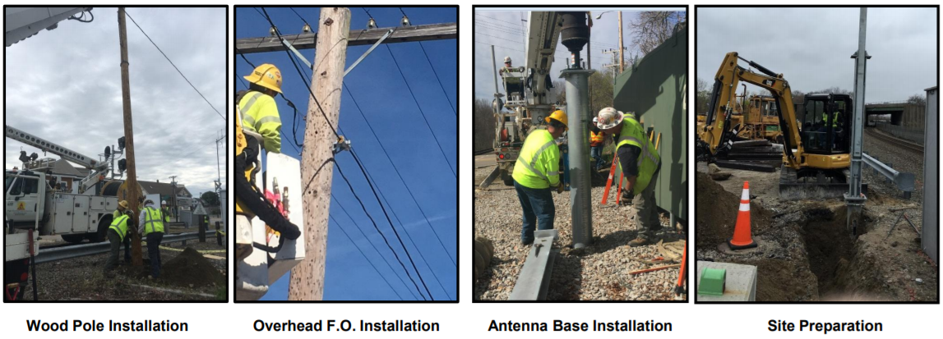
Sustainability Project - Positive Train Control (Safety)
The PTC project uses a GPS-based safety technology capable of preventing train-to-train collisions, over-speed derailments, and other potential safety issues. Estimated Project Cost: $492M.
Implementation of MBTA’s PTC System will bring all 394 route miles, 922 employees, and 187 signal towers into compliance with the federally mandated PTC requirements by the December 31, 2018 deadline with extension(s) to meet the final deadline of December 31, 2020
Safety for riders and employees is improved by significantly reducing the probability of:
Collisions between trains
Casualties to passengers and roadway workers
Damage to equipment
Over speed derailments and accidents

Slide 7
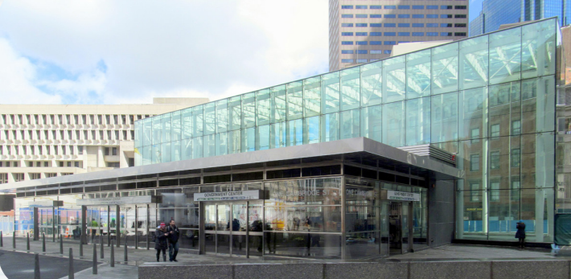
Sustainability Project - Government Center (Accessibility and Climate Resiliency)
Work continues to renovate Government Center Station. 2016 marked the first time the 118 year old station was accessible to people with disabilities. Estimated Project Cost: $99M.
Modernization created an efficient, attractive, functional station accessible to all customers
Exterior glass, treated to increase insulation, provides natural light throughout the station. Glass-block flooring allows the light to pass through to subterranean levels
Water drainage from roof is used to water landscaping
Entirely new electrical system is more efficient, including a ventilation system that requires 60% less electricity
Minimum 25% recycled materials used for all structural concrete
Hazardous materials used during original construction, such as lead and asbestos, were systematically removed at beginning of project

Slide 8
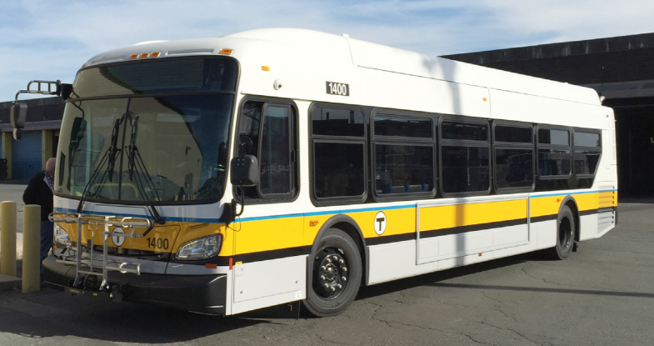
Sustainability Project - Fleet Modernization (Pollution Prevention)
MBTA is assembling a modern bus fleet, with old busses being replaced with fuel-efficient hybrid vehicles that consume 44% less fuel. Estimated Project Cost: $332M.
First hybrid buses entered service in 2010, with 25 60-foot articulated hybrids used on the Silver Line.
60 diesel buses replaced with hybrids during 2014
150 hybrid buses entered service in 2017
Integrated Fleet and Facilities Plan calls for
194 40-foot Hybrid Buses (delivery 2018-2019)
30 60-foot Zero Emissions Buses (delivery 2021)
460 40-foot Buses (delivery 2021-25)
Hybrid Buses by the Numbers
Hybrid Units in Service EOY 2017
235 Buses
Annual Diesel Reduction
830k Gallons
Annual Greenhouse Gas Reduction
3.7M Pounds

