Slide 1
The Municipal Analysts Group of New York
What’s New With the GASB and What Does It Mean for Municipal Credit?
Mr. Bean.

Slide 2
Presentation Overview
What information is and will be available in the financial statements for pensions and other postemployment benefits (OPEB)
What are the new debt disclosure requirements
What else is coming down the road

Slide 3
Pensions and OPEB

Slide 4
Information Displayed in the Financial Statements

Slide 5
What Is Reported in Financial Statements?
Government-wide and other accrual-basis statements
  Net OPEB liability and deferrals, in the statement of net position
  However, total OPEB liability if no assets have been set aside in a trust that meets specified criteria
  OPEB expense allocated among programs and functions, in the statement of activities (total expense disclosed in notes)
Governmental funds
  Payable to OPEB plan for contributions/payments normally due and payable but not made prior to FYE, in the balance sheet
  OPEB expenditure equal to contributions/payments normally due and payable, in statement of revenues, expenditures, and changes in fund balance

Slide 6
How Is the Long-Term Obligation Measured?
Project cash outflows for benefits
Discount projected benefits to actuarial present value (APV)
Allocate the APV of projected benefits to periods
APV allocated to past periods of service
= total OPEB liability

Slide 7
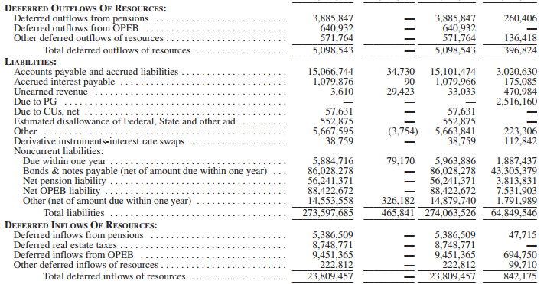
Statement of Net Position

Slide 8
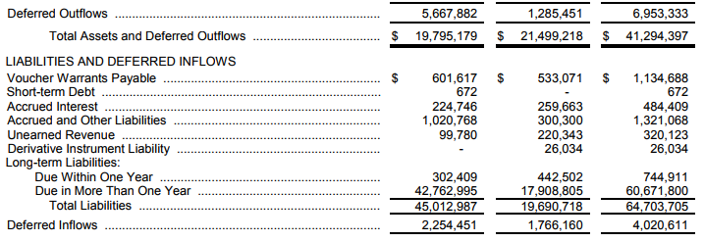
Statement of Net Position

Slide 9
Information in the Notes

Slide 10
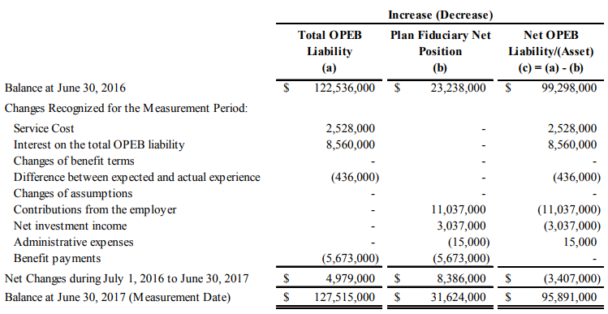
Changes in the NOL
Notes:
Single and agent employers only

Slide 11
Changes in the TOL
Notes:
If there is no fiduciary net position

Slide 12
Descriptive Information
Members by type
Assumptions used to measure the liability
Notes:
Members by type disclosed for single and agent plans

Slide 13
Measurement of the NOL
The county’s net OPEB liability for the fiscal year ended June 30, 2018, was measured as of June 30, 2017. The total OPEB liability used to calculate the net pension liability was determined by an actuarial valuation performed as of June 30, 2016, using update actuarial assumptions, applied to all periods included in the measurement and rolled forward to the measurement date of June 30, 2017.

Slide 14
Use of a Municipal Bond Rate
The city does not make actuarially determined employer contributions to the plan. Consequently, there is no fiduciary net position available to make project future benefit payments of current plan members. Therefore, a municipal bond index rate based on the 20-year Bond Buyer GO Index (4.29% at June 30, 2017) was applied to all periods of projected benefit payments to determine the total OPEB liability.
Notes:
Disclose municipal bond rate, its source, and the periods it was applied to.

Slide 15
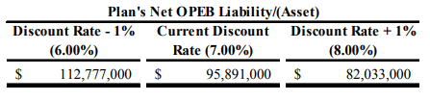
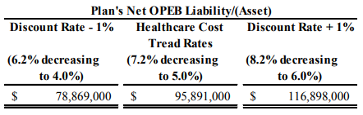
Sensitivity Analysis
Notes:
Cont

Slide 16
Deferrals
Amounts reported as deferred inflows of resources and deferred outflows of resources will be recognized in OPEB expense over an additional 5–7 years, as follows:

Slide 17
Asset Sufficiency (like a funding ratio)
24.8%
Notes:
Single and agent employers only

Slide 18
Information in the Supporting Schedules

Slide 19
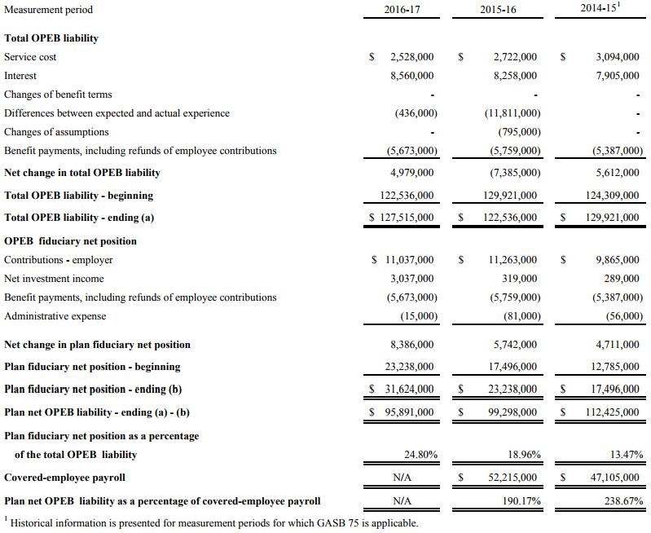
Changes
in NOL and ratios
Notes:
This schedule will be compiled prospectively. You may see the ratios section at the bottom in a separate schedule.
Single and agent plans only

Slide 20
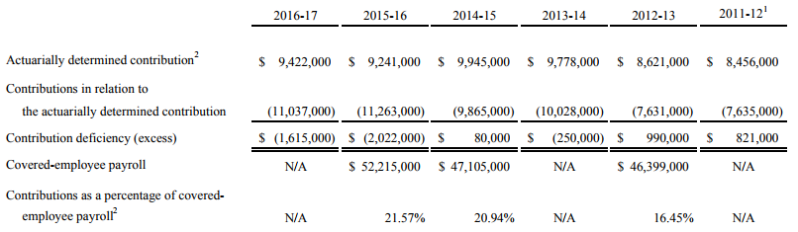
Actuarially Determined Contributions
Notes:
Covered payroll instead if OPEB is based on a measure of pay

Slide 21
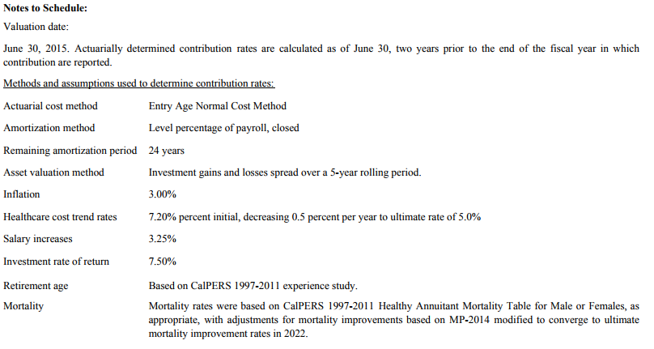
Notes to the Contributions Schedule

Slide 22
Debt Disclosures

Slide 23
Definition of Debt for Disclosure Purposes
For purposes of disclosure in notes to financial statements, debt is defined as:
  A liability that arises from a contractual obligation to pay cash (or other assets that may be used in lieu of cash) in one or more payments to settle an amount that is fixed at the date the contractual obligation is established.
    For disclosure purposes, debt does not include leases, except those contracts reported as a financed purchase of the underlying asset, or accounts payable.
    For purposes of this determination, interest to be accrued and subsequently paid (such as interest on variable-rate debt) or interest to be added to the principal amount of the obligation (such as interest on capital appreciation bonds) does not preclude the amount to be settled from being considered fixed at the date the contractual obligation is established.

Slide 24
New Note Disclosures
Summarized information about the following items:
  Amount of unused lines of credit
    Not limited to lines of credit associated with debt
  Assets pledged as collateral for debt
    Does not include assets constructed with the related debt proceeds
  Terms specified in debt agreements related to significant:
    Events of default with finance-related consequences
    Termination events with finance-related consequences
    Subjective acceleration clauses.
Separate information in debt disclosures regarding (a) direct borrowings and direct placements of debt from (b) other debt

Slide 25
What Is Coming Down the Road

Slide 26
Effective Date—June 30
2019—Statement 83—Certain Asset Retirement Obligations
2020—Statement 84—Fiduciary Activities
2021—Statement 87—Leases

Slide 27
Technical Agenda—What Should Be On Your Radar
Current Agenda
  Reporting model (reexamination)
  Revenue and expense recognition
Research Agenda
  Note disclosures (reexamination)
  Going concern
  Information technology, including cloud computing
  Public private partnerships

Slide 28
Questions?
For more information, check out www.gasb.org.

