Slide 1
Update on State Fiscal Conditions 2015-2016
Scott Pattison
Executive Director
NASBO
MAGNY
June 12, 2015

Slide 2
States
Overall

Slide 3
Overall
Modest Growth (Mirror Economy)
Most States: Good/Decent
Tough Challenges and Decisions (11)
Some States Very Difficult (Oil prices, etc.)

Slide 4
State Fiscal Overview
Fiscal 2015 marks the 5th year increase in general fund spending and revenues
Signs of fiscal distress have subsided and the fiscal environment for most states is good
Not post-WWII normal patterns of growth

Slide 5
Structural Imbalances Will Persist
Year ago % change, calendar year
CMS state Medicaid spending forecast
%
Moody’s Analytics state tax revenue forecast
Sources: Moody’s Analytics, CMS, Census Bureau

Slide 7
Economic Situation
Impact on States

Slide 8
Economy
GDP:
1st Q 0.2% - Flat
Federal Reserve projects 2.5% GDP growth in 2015, 2.5% in 2016
Other economic figures:
Unemployment rate remains at 5.4%
Consumer spending rose 0.4%
Consumer price index rose 0.2%
600,000+ less state and local employees since ‘08

Slide 9
GF Spending Expected to Grow for 5th Straight Year, Although Below Average
37-year historical average rate of growth is 5.5 percent *Fiscal 2015 numbers are enacted Source: NASBO Fall 2014 Fiscal Survey of States

Slide 10
GDP Growth by Region (2011-2014)

Slide 11
Motor Vehicle Production Increasing Much Faster Than MV Employment
Source: Michigan Department of Treasury 2014-2016 estimates and Bureau of Labor Statistics
11

Slide 12
State Variation

Slide 13
State General Obligation Ratings – July 2014 (from Citi)
Washington
Aa1/AA+/AA+
NH
Aa1/AA/AA+
Montana
Aa1/AA/AA+
North Dakota
(Aa1)/(AAA)/NR
Vermont
Aaa/AA+/AAA
Maine
Aa2/
AA/AA
Oregon
Aa1/AA+/AA+
Minnesota
Aa1/
AA+/AA+
South Dakota
Aa2*/(AA+)/(AA+)
Wisconsin
Aa2/
AA/AA/AA
West Virginia
Aa1/AA/AA+
MA
Aa1/AA+/AA+
Idaho
(Aa1)/(AA+)/(AA+)
Wyoming
NR/(AAA)/NR
New York
Aa1/
AA/AA+
Michigan
Aa2/
AA-/AA
RI Aa2/AA/AA
Nevada
Aa2/AA/AA+
Nebraska
Aa2*/(AAA)/NR
Iowa
(Aaa)/(AAA)/(AAA)
Pennsylvania
Aa2/AA/AA
CT Aa3/AA/AA/AA
Utah
Aaa/AAA/AAA
Illinois
A3/A-/A-
Indiana
(Aaa)/
(AAA)/
(AAA)
Ohio
Aa1/
AA+/AA+
NJ A1/A+/A+
Colorado
(Aa1)/(AA)/NR
DE Aaa/AAA/AAA
California
Aa3/A/A
Kansas
(Aa2)/(AA+)/NR
Missouri
Aaa/
AAA/AAA
MD Aaa/AAA/AAA
Kentucky
(Aa2)/(AA-)/NR
DC Aa2/AA-/AA-
Virginia
Aaa/AAA/AAA
Arizona
(Aa3)/(AA-)/NR
New Mexico
Aaa/AA+/NR
Oklahoma
Aa2/(AA+)/AA+
Arkansas
Aa1/AA/NR
Tennessee
Aaa/AA+/AAA
North Carolina
Aaa/AAA/AAA
Alabama
Aa1/
AA/AA+
Georgia
Aaa/
AAA/AAA
South Carolina
Aaa/AA+/AAA
Texas
Aaa/AAA/AAA
Louisiana
Aa2/AA/AA
Alaska
Aaa/AAA/AAA
Mississippi
Aa2/AA/AA+
Puerto Rico
B2/BB+/BB-
Hawaii
Aa2/AA/AA
Florida
Aa1/AAA/AAA
Aaa/AAA
Guam NR/BB-/NR
One Aaa/AAA
Aa/AA
One Less than Aa3/AA-
Order of Ratings: Moody’s/S&P/Fitch/Kroll as of July 10, 2014.
*Lease revenue and/or Certificate of Participation (“COP”) rating
NR: General Obligation Debt is Not Rated
( ) Indicates issuer credit rating which is equivalent to a General Obligation rating

Slide 14
Regions
West
South
Midwest
Northeast
Sluggish -- last two years
Demographics
Old manufacturing
Foreclosures

Slide 15
Variation
Energy States
Taxes
Federal Cuts
Modest Growth
Voter Initiatives
Court Cases

Slide 16
Revenue Volatility
Source: Fiscal Studies Program, Rockefeller Institute of Government; U.S. Census Bureau
*3rd quarter of 2014 is based on 45 early reporting states

Slide 17
Energy States

Slide 18
State Severance Tax Revenue as a Percentage of Total State Tax Collections
%
Source: U.S. Census Bureau

Slide 19
Taxes
Severance tax states will continue to have some of the most volatile revenue sources
Most have done a good job building up reserves
Oil prices expected to rebound rest of 2015 and into 2016
States will likely continue to examine tax structures
Income Tax Volatility and Sales Tax Weakness
Impacts of: Slow economic growth, uncertainty regarding future federal funds, tough competition for general funds, infrastructure demands, ong-term liabilities

Slide 20
State Challenges
…and the POLITICS

Slide 21
Spending by Funding Source (Percentage)
Source: NASBO State Expenditure Report

Slide 22
Total State Expenditures by Function Estimated Fiscal 2014
Source: NASBO State Expenditure Report

Slide 23
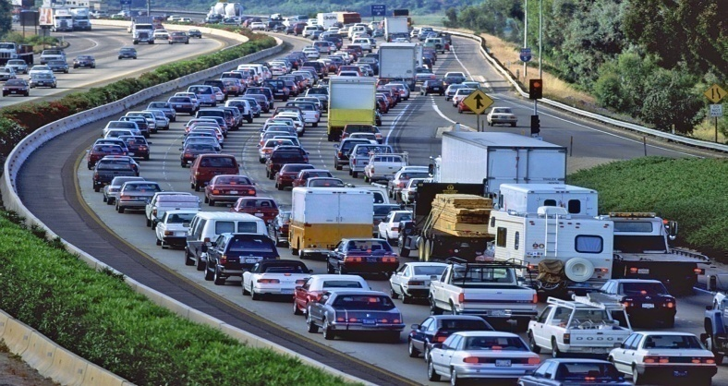
Long Term Spending Pressures:
Medicaid and Health Care
K-12 and Higher Education
Demographic Changes
Corrections
Infrastructure
Pensions
Retiree Health Care

Slide 24
Top Issues
Infrastructure
Education
Revenues
Liabilities (Pensions)
Shortfalls (Some States)
Other Revenue Issues (Tolls, Sin Taxes)
Health Care (Medicaid Issues)***

Slide 25
Choices
Targeted Cuts
Across the Board Cuts
Taxes
Reorganize Agencies
Cuts to Employee Benefits
Reduce Local Aid
Fees
Higher Education Related Fees
And more…
Source: NASBO Fall 2014 Fiscal Survey of States

Slide 26
26

Slide 27
Current Fiscal Situation:
Indicators

Slide 28
States Reserves Haven’t Reached Peak Levels

Slide 29
Minimal Midyear Budget Cuts So Far in Fiscal 2015
Source: NASBO Fall 2014 Fiscal Survey *Fiscal 2015 midyear cuts are ongoing

Slide 30
General Fund Expenditures by Function Estimated Fiscal 2014
Source: NASBO State Expenditure Report

Slide 31
Federal Funds Expenditures by Function Estimated Fiscal 2014
Source: NASBO State Expenditure Report

Slide 32
Revenue Sources in the General Fund (Percentage)
Source: NASBO State Expenditure Report

Slide 33
Revenue Sources in GF Relatively Consistent
1998
2014

Slide 34
Pension Funding Up
Source - NASRA: The ARC Experience of State Retirement Plans, FY 01 to FY 13, March 2015

Slide 35
Outlook

Slide 36
Trend Continues: Focus on Outcomes
Focus on results
Spend funds for effective programs
Improve management

Slide 37
State Fiscal Outlook
Growth
Revenue stable in FY 2015
Federal govt uncertainty
Tough competition for general funds
Dealing with infrastructure, long-term liabilities
Painful choices

Slide 38
www.nasbo.org
Scott D. Pattison
Executive Director
NASBO
202-624-8804
spattison@nasbo.org

