Slide 1
A Discussion on the State of New Jersey
John A. Sugden
Sr. Director
U.S. States Group, USPF
October 14, 2014
Notes:
Art Visual Theme: Transparency/Transformation/Insight/Understanding

Slide 2
U.S. State Rating Distribution
As of April 2, 2013
Notes:
Initially rated AAA in 1961
Lowered to AA+ in 1991
Lowered to AA in 2002
Lowered to AA-

Slide 3
How Did We Get Here?

Slide 4
Economy
Diverse economy that benefits from proximity to NYC and participation in broader economy
High per capita gross state product and high per capita income
New Jersey’s economy is growing, but not at a rate sufficient to match growth in fixed costs
Large scale construction projects could benefit economy
Challenges related to housing, pharma, and Atlantic City remain

Slide 5
Factors Driving Recent Downgrades
Trend of structurally unbalanced budgets and reliance on one-time measures, despite generally improving economic conditions
Increased long-term pressures in managing its long-term liabilities, contributing to growing misalignment of revenues and expenditures
Lack of consensus among elected leaders on how to return to structural balance
Limited flexibility with which to address shortfalls due to timing of revenue receipts and size of reserves
Notes:
Growing cost pressures associated with long-term liabilities and need for investment in education, employee healthcare, and infrastructure
Limited revenue enhancement measures
Optimistic revenue assumptions that have fallen short of expectations

Slide 6
NJ’s Reliance on 1x Measures
Deferral of Homestead Benefit
Adjustment, deferral, reduction to pension payments
Revenue reductions due to corporate and gross income tax cuts
Debt restructurings with upfront savings
Legal Settlements
Reliance on untested revenues
Monetization of future revenues

Slide 7
Limited Reserves
The state has used its reserves to close budgetary gaps and address mid-year gaps
Level of reserves seems to have stabilized at around $300 million, or less than 1% of budget, over the past few years
For fiscal 2015, the budget assumes opening reserves of $300 million and year-end reserves of $388 million
Additional fiscal 2014 year-end revenue shortfalls could bring this expected level into question

Slide 8
Fiscal 2015 Budget
Total budget is $32.5 billion, down from initial $34.5 billion estimate
Total budget projected to grow by 3.5%
Structural gap of $2.6 billion, or 8% of budget, closed with use of 1x measures and reduction of pension payment
Year to date revenues seem to be tracking estimate as of August, but it is still early in the fiscal year
Notes:
Gap, assuming full ARC payment, would grow to $4.4 billion, or 13.6% of budget.
Areas to watch:
Beginning fund balance
New revenue enhancements
Educational formula

Slide 9
Long Term Challenges

Slide 10
Above Average Debt Burden
Total net tax supported debt of $34.9 billion as of FYE 2014- a slight decline from 2013
Debt service carrying charge is 10.2% of 2015 budget
Reduced exposure to variable rate debt over time
Restructuring debt to help close budget gaps and manage cash flow
Privately placed $2.6 billion in TRANs
$1.15 billion in non-amortizing FRNs to match floating to fixed swaps
Notes:
Rankings

Slide 11
Pension Funded Ratio

Slide 12
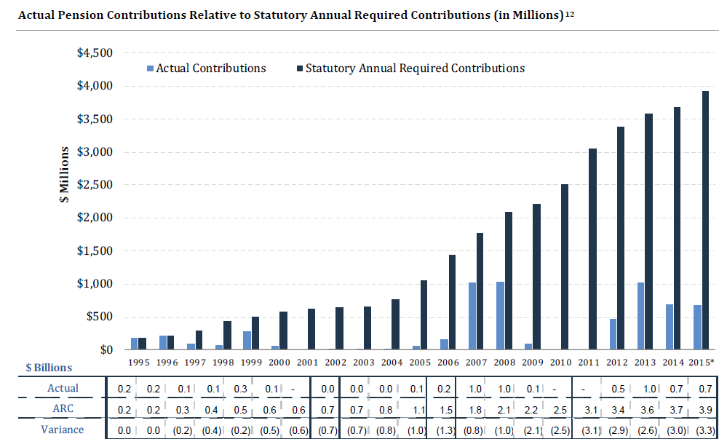
NJ’s Pension Contributions
Source: Status Report of the New Jersey Pension and Health Benefit Study; *projected

Slide 13
Pension and OPEB
Pension payments reduced to balance 2014 and 2015 budget
Judge ruled in favor of FY2014 payment reduction, recognizing Gov.’s authority to reduce spending to balance budget
Continued litigation on pension reform and pension payments
Currently using a 7.9% assumed rate of return
Could be lower based on GASB 67 & 68

Slide 14
Pension and OPEB
OPEB liability estimated at $53 billion as of 2013
OPEB funded on a pay as you go basis
New Jersey Pension and Health Benefit Study Commission to study both pensions and employee health benefits
Released initial findings, but final recommendations have not been released

Slide 15
Outlook

Slide 16
Stable Outlook
State retains strong ability to fund its debt
Expect to continue to manage budget gaps
Could see some additional deterioration in pension funding in the short term, but expect action on pension reform
Liquidity strain or continued budget weakness could trigger action sooner
Limited upside potential

Slide 17
Impact on Local Governments

Slide 18
Local Credits
Local credits have been able to manage through the cuts at the state level
Pension funding has been stronger at the local level
Local credits tend to be highly rated, with some notable exceptions
Role of the Local Finance Board is seen as positive
To date, impact has been manageable

Slide 19
Atlantic City
AC’s gaming industry has been experiencing revenue declines due to increased competition, namely Pennsylvania; Online gaming could also impact visits to AC
Restructuring of industry underway with 4 out of 12 casinos closing
Closures taking a toll on property tax revenues
Potential loss of employment estimated at 8,000 to 11,000, depending on Trump Taj Mahal
Sale of Revel, development of Bass Pro Shop and Harrah’s Conference Center are positive

Slide 20
Thank You
John Sugden
Sr. Director
T: 212.438.1678 | F: 212.438.0140
John.sugden@standardandpoors.com

Slide 21
Copyright © 2013 by Standard & Poor’s Financial Services LLC. All rights reserved.
No content (including ratings, credit-related analyses and data, valuations, model, software or other application or output therefrom) or any part thereof (Content) may be modified, reverse engineered, reproduced or distributed in any form by any means, or stored in a database or retrieval system, without the prior written permission of Standard & Poor’s Financial Services LLC or its affiliates (collectively, S&P). The Content shall not be used for any unlawful or unauthorized purposes. S&P and any third-party providers, as well as their directors, officers, shareholders, employees or agents (collectively S&P Parties) do not guarantee the accuracy, completeness, timeliness or availability of the Content. S&P Parties are not responsible for any errors or omissions (negligent or otherwise), regardless of the cause, for the results obtained from the use of the Content, or for the security or maintenance of any data input by the user. The Content is provided on an “as is” basis. S&P PARTIES DISCLAIM ANY AND ALL EXPRESS OR IMPLIED WARRANTIES, INCLUDING, BUT NOT LIMITED TO, ANY WARRANTIES OF MERCHANTABILITY OR FITNESS FOR A PARTICULAR PURPOSE OR USE, FREEDOM FROM BUGS, SOFTWARE ERRORS OR DEFECTS, THAT THE CONTENT’S FUNCTIONING WILL BE UNINTERRUPTED OR THAT THE CONTENT WILL OPERATE WITH ANY SOFTWARE OR HARDWARE CONFIGURATION. In no event shall S&P Parties be liable to any party for any direct, indirect, incidental, exemplary, compensatory, punitive, special or consequential damages, costs, expenses, legal fees, or losses (including, without limitation, lost income or lost profits and opportunity costs or losses caused by negligence) in connection with any use of the Content even if advised of the possibility of such damages.
Credit-related and other analyses, including ratings, and statements in the Content are statements of opinion as of the date they are expressed and not statements of fact. S&P’s opinions, analyses and rating acknowledgment decisions (described below) are not recommendations to purchase, hold, or sell any securities or to make any investment decisions, and do not address the suitability of any security. S&P assumes no obligation to update the Content following publication in any form or format. The Content should not be relied on and is not a substitute for the skill, judgment and experience of the user, its management, employees, advisors and/or clients when making investment and other business decisions. S&P does not act as a fiduciary or an investment advisor except where registered as such. While S&P has obtained information from sources it believes to be reliable, S&P does not perform an audit and undertakes no duty of due diligence or independent verification of any information it receives.
To the extent that regulatory authorities allow a rating agency to acknowledge in one jurisdiction a rating issued in another jurisdiction for certain regulatory purposes, S&P reserves the right to assign, withdraw or suspend such acknowledgement at any time and in its sole discretion. S&P Parties disclaim any duty whatsoever arising out of the assignment, withdrawal or suspension of an acknowledgment as well as any liability for any damage alleged to have been suffered on account thereof.
S&P keeps certain activities of its business units separate from each other in order to preserve the independence and objectivity of their respective activities. As a result, certain business units of S&P may have information that is not available to other S&P business units. S&P has established policies and procedures to maintain the confidentiality of certain non-public information received in connection with each analytical process.
S&P may receive compensation for its ratings and certain analyses, normally from issuers or underwriters of securities or from obligors. S&P reserves the right to disseminate its opinions and analyses. S&P's public ratings and analyses are made available on its Web sites, www.standardandpoors.com (free of charge), and www.ratingsdirect.com and www.globalcreditportal.com (subscription), and may be distributed through other means, including via S&P publications and third-party redistributors. Additional information about our ratings fees is available at www.standardandpoors.com/usratingsfees.
STANDARD & POOR’S, S&P, GLOBAL CREDIT PORTAL and RATINGSDIRECT are registered trademarks of Standard & Poor’s Financial Services LLC.

