Slide 1
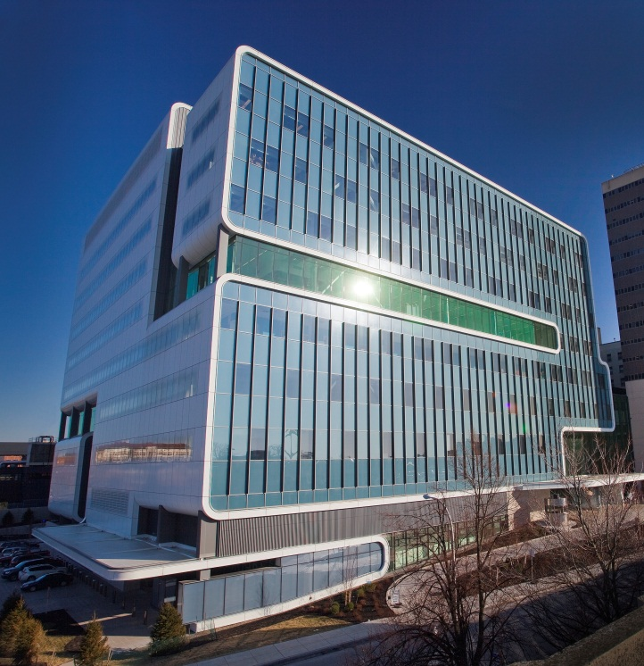
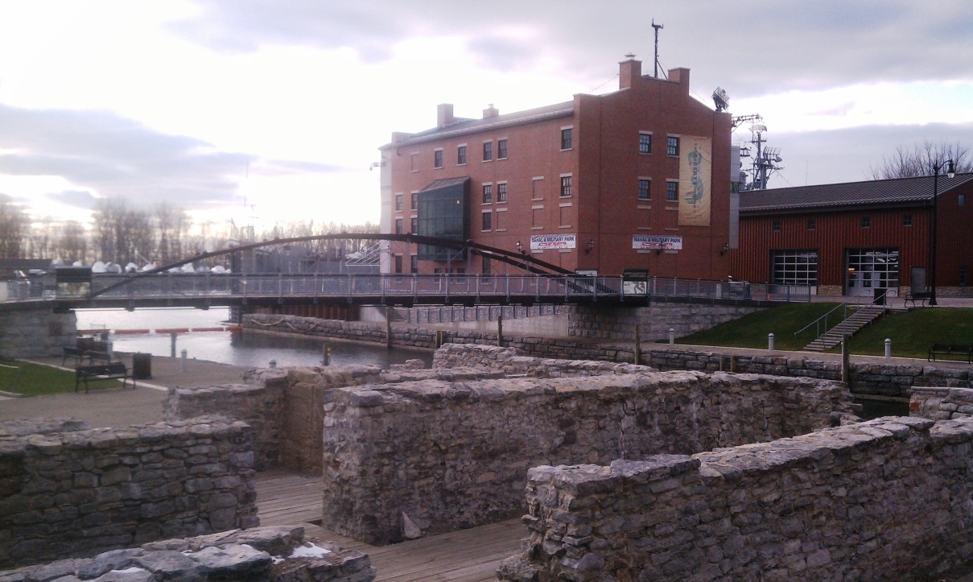
Buffalo
Reinventing a City
Buffalo Comptroller
Mark J.F. Schroeder

Slide 2
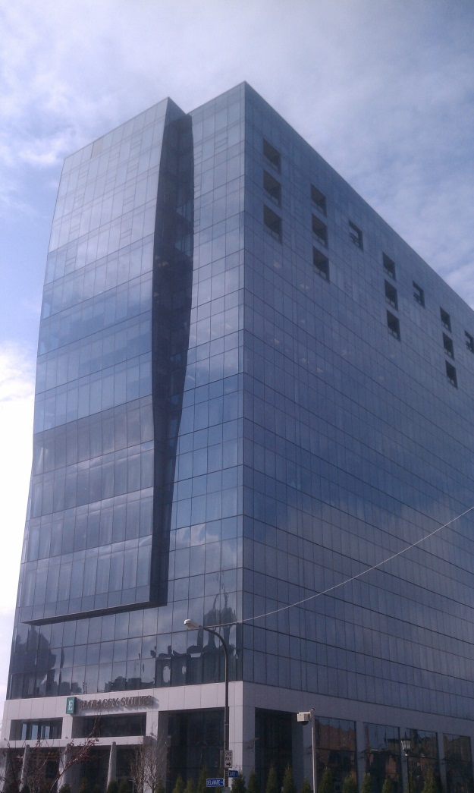
Introduction
Buffalo Comptroller Mark J.F. Schroeder
About Buffalo

Slide 3
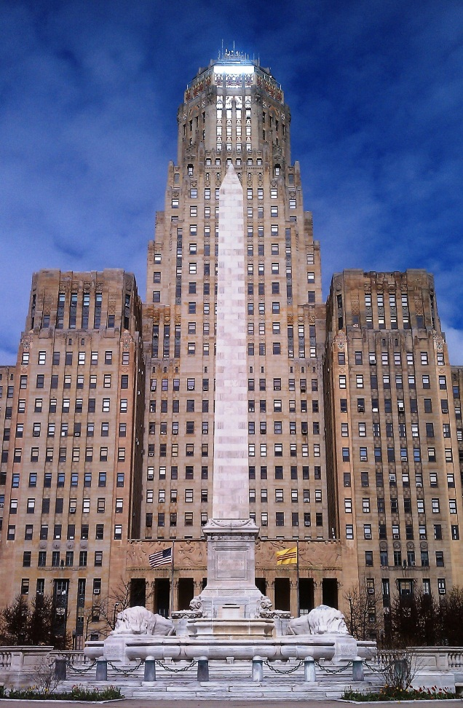
Buffalo’s Story
Stabilization of the City’s Finances
Revitalization of the Economy

Slide 4
City Finances
2003
Fund Balance: $36 million
88% of Constitutional Tax Limit exhausted
$435 million debt burden
State-imposed Hard Control Board, Buffalo Fiscal Stability Authority (BFSA)
Ratings= Moody’s: Baa3, S&P: BBB-

Slide 5
City Finances
2013
Fund Balance: $166 million
68% of Constitutional Tax Limit exhausted
$288 million debt burden
Buffalo Fiscal Stability Authority (BFSA) currently in advisory status
Ratings= Moody’s: A1, S&P: A+, Fitch: A+

Slide 6
City Finances
Recent Initiatives
Amend City Charter to require 4-year financial plan
Debt policy to issue less debt than is retired each year
Debt refinancing yielded $62 million in savings since 2012
Establishment of Emergency Stabilization (Rainy Day) Fund for unanticipated, non-recurring expenses
Investment of Idle Funds
Published Popular Annual Financial Report (PAFR)

Slide 7
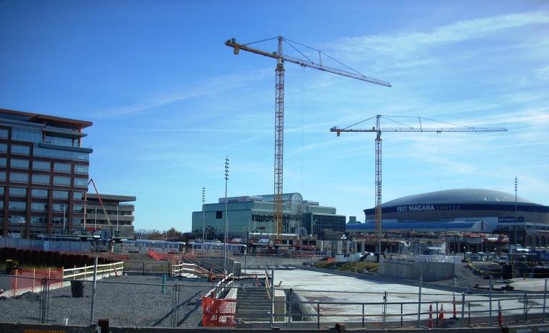
Economic Rebirth
Highlights
Buffalo Niagara Medical Campus
Higher Education
High-Tech Industry
Waterfront Development
Improved Housing Market
HARBORCenter construction

Slide 8
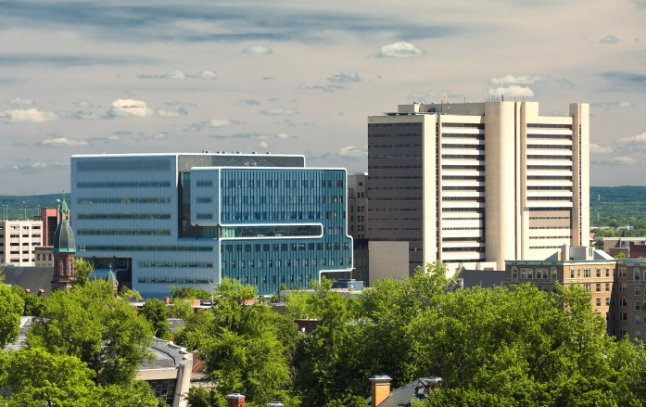
Buffalo Niagara Medical Campus
120-acre site adjacent to downtown
Consortium of region’s top health care, education, and research institutions
7,000 employees in 2002
12,000 employees currently
17,000 employees by 2016

Slide 9
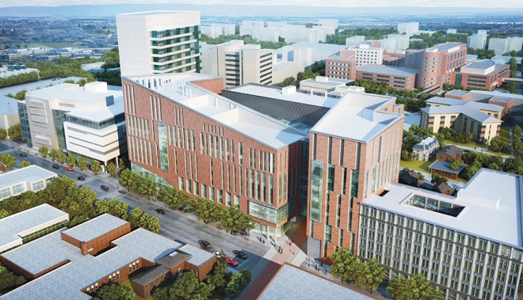
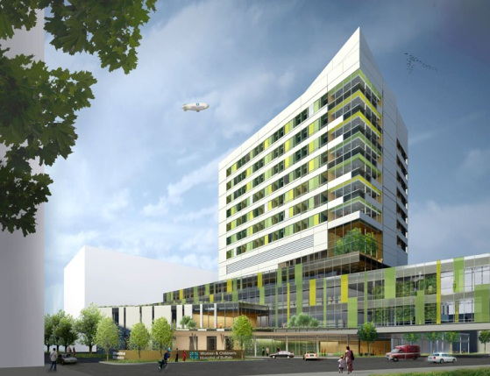
Buffalo Niagara Medical Campus
Major Projects
Gates Vascular Institute - $292 million (Completed)
University at Buffalo Medical School - $375 million (Under construction – completed by 2016)
Kaleida ‘s Children’s Hospital - $250 million (Groundbreaking this spring – completed by 2016)
Conventus medical offices - $100 million (Under construction – completed by 2015)
Genomic Medicine & Supercomputing Center - $105 million (Announced in January)
University at Buffalo Medical School
Kaleida’s Children’s Hospital

Slide 10
Higher Education
Buffalo Area
21 Colleges and Universities
113,000 students
32,000 employees
$ 4 billion economic impact
10 percent of local economy

Slide 11
University at Buffalo
Largest public university in NYS
28,000 students across 3 campuses
UB2020 - Comprehensive plan to increase jobs, enrollment, and research funding
Expected to create nearly 5,000 jobs

Slide 12
High Tech
Advanced Manufacturing
Buffalo High-Tech Manufacturing Innovation Hub @ RiverBend
$1.7 billion clean energy campus
850 jobs within 3 years (5,000 in later years)
Soraa & Silevo each investing $750 million
NYS investing $225 million

Slide 13
High Tech
Information Technology
IBM to bring 500 jobs to Downtown Buffalo
100,000 square-foot computer information technology center
Will create cutting-edge software for energy, health, defense and other industries
Expected to open in 2015

Slide 14
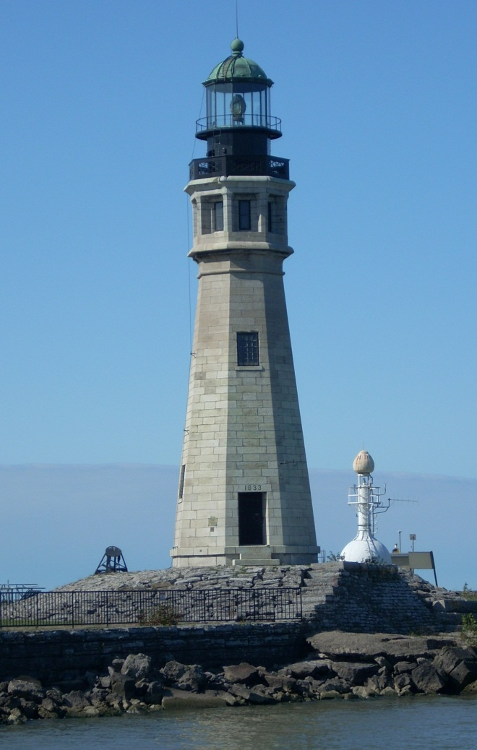
Waterfront Development
Canalside
HARBORCenter
Outer Harbor
Buffalo River

Slide 15
Waterfront Development
Blends public access with private development
Replica canals, wharf, restaurant, museum, pedestrian bridges
$30 renovation of former state office building
Already has leveraged $250 million in private development

Slide 16
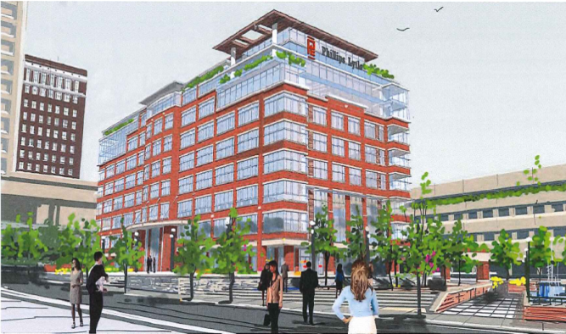
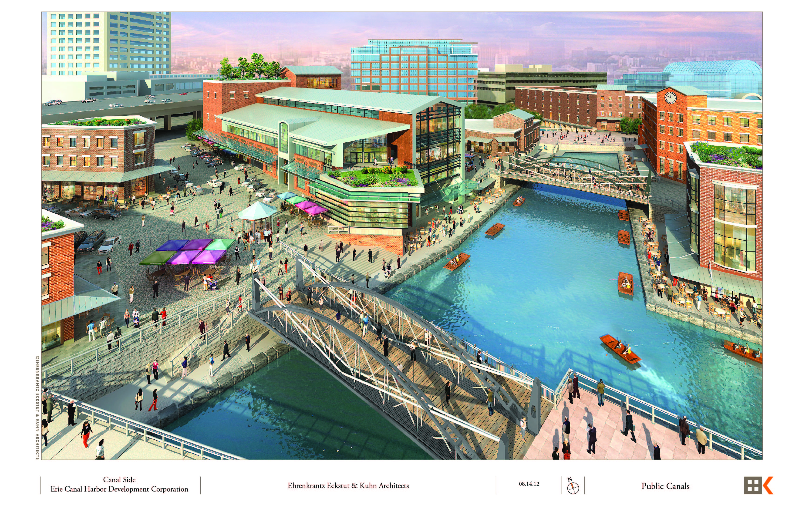
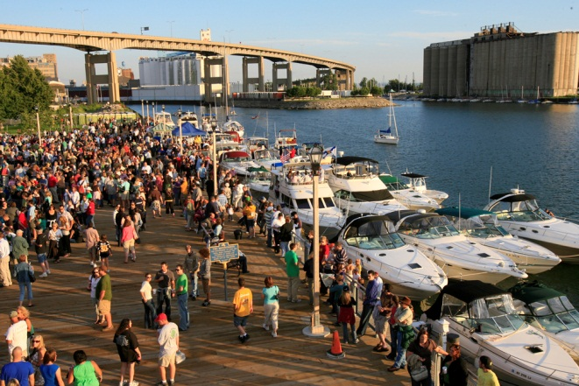
Waterfront Development

Slide 17
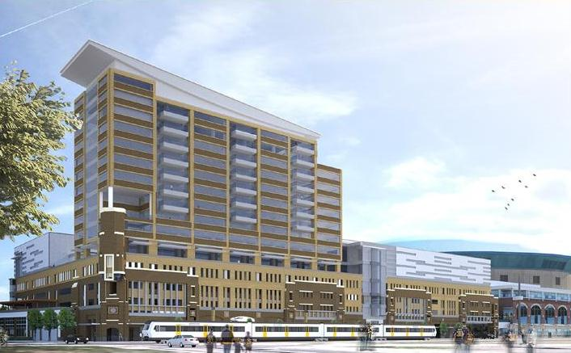
Waterfront Development
HARBORCenter
$172 million project by Buffalo Sabres
Adjacent to Canalside, connects to FNC
Two ice rinks, 200-room hotel, retail, and sports bar & grill
Opens in fall 2014, Hotel in Spring 2015

Slide 18
Waterfront Development
Outer Harbor
Transfer from NFTA to Erie Canal Harbor Development(Canalside) and NYS Parks
Wilkeson Pointe Park
Gallagher Pier State Park
Small Boat Harbor

Slide 19
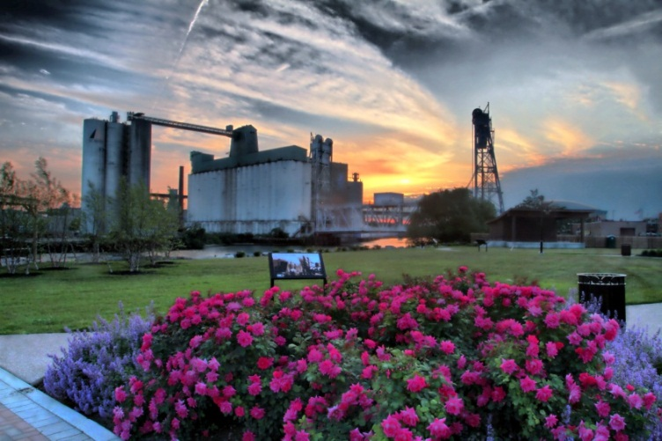
Waterfront Development
Buffalo River
Riverfest Park
Mutuals Park
Riverworks
Hydraulics (Larkinville)
$11 million Ohio Street Parkway (Connects to Canalside & Outer Harbor)
Riverfest Park

Slide 20
Housing
Buffalo Area
16% increase in home prices since 2006
Highest increase among top 100 metros
Some neighborhoods increased up to 43%
7% increase in home prices in 2013
Source: Clear Capital (1/14 issue of Kiplinger’s Personal Finance)

Slide 21
Demographics
City of Buffalo
Private sector jobs grew by .8% in 2013 (approx. 4,400 jobs)
Unemployment down from 11.1% in 2012 to 9.9% in 2013
Median Household Income increased 4.6% from 2011-2012

Slide 22
Economic Rebirth
Economic Diversification
Transition from manufacturing based economy
Growth of other sectors
High Tech
Medical
Education

Slide 23
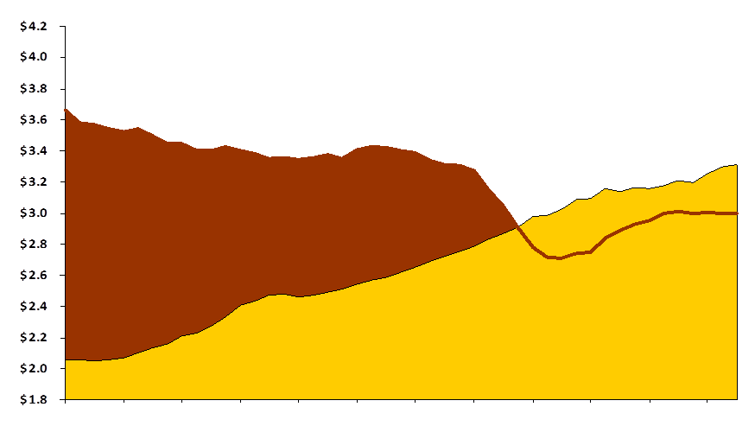
Economic Rebirth
Buffalo Metro Area Payroll Income
(In Billions)
$3.3
$3.0
Manufacturing
Private Heath Care
& Education
Source: New York State Dept. of Labor
2002 2003 2004 2005 2006 2007 2008 2009 2010 2011 2012 ‘13
Courtesy M&T Bank

Slide 24
Economic Rebirth
Buffalo
113.0%
Dec 2013
41,000 Jobs
Job Count as Percentage of January 2007 Total
Professional, Scientific, Technical and
Business Management Employment
Buffalo Metro Area vs. United States
109.5%
United
States
36,300
Jobs
Buffalo
Manufacturing
Net Gain Since
January 2007
4,700 jobs
Sources: U.S. Bureau of Labor Statistics,
New York State Department of Labor Note: Buffalo data seasonally adjusted
2007 2008 2009 2010 2011 2012 2013
Courtesy M&T Bank

Slide 25
Economic Rebirth
WNY Population
Ages 20-34
Percent Increase/decrease
10.1%
Buffalo Area
(Erie & Niagara Counties)
7.4%
United
States
Allegany, Cattaraugus, Chautauqua
Genesee, Orleans & Wyoming Counties
3.2%
00 01 02 03 04 05 06 07 08 09 10 11 12
Courtesy M&T Bank
Source: U.S. Census Bureau

Slide 26
Economic Rebirth
Path Forward
Continued Fiscal Discipline by City
Continued Investment in Technology, Medical, and Higher Education
Smart Growth, Reduce Sprawl
Leverage City’s Natural Assets (Waterfront, Educated Workforce, Infrastructure, Cultural Attractions, Proximity to Canada)

Slide 27
Buffalo: A Smart Investment
$33 million issuance
$25.6 million General Improvement Serial Bonds
$7.4 million Bond Anticipation Notes (BAN)
Moody’s: A1, S&P: A+, Fitch: A+
Issuances expected to price via competitive sale on April 16th

