Slide 1
A Reliable and Resilient Water Supply and Wastewater Utility for the 21st Century
Angela Licata
Deputy Commissioner, Sustainability NYCDEP
June 7th, 2013

Slide 2
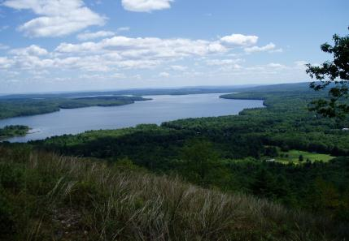
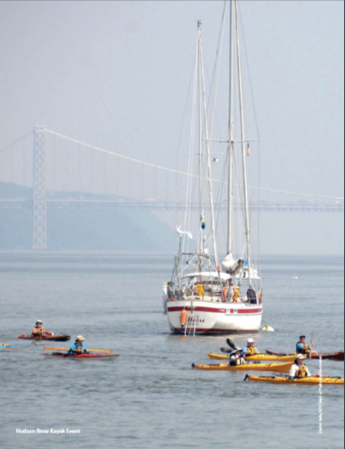
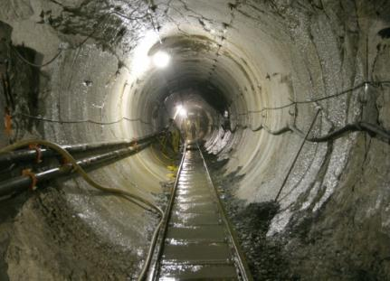
About DEP: Overview
Supply 1.2 billion gallons of water per day to 9.3 million people
  19 storage reservoirs and 3 controlled lakes
  295 miles of aqueduct and tunnels
  7,000 miles of water mains
  109,000 fire hydrants
Treat 1.3 billion gallons of wastewater per day
  14 In-city treatment plants; 8 upstate
  96 pump stations
$14 billion in
active construction
and design projects

Slide 3
DEP Capital Spending
Since 2001 DEP has spent:
Drinking Water:
$7.7B+ capital investments $4.0B+ operational expenses
Wastewater and Sewer:
$12.7B+ capital investments $5.1B+ operational expenses
------------------------------------------
Over the past 20 years – CSO capture increased from 30% to 72% annually
Sewage is a smaller proportion of overflows, decreasing from 30% by volume in the 1980s to 12% in 2010
Source: New York City Office of the Comptroller, Comprehensive Annual Financial Report, Fiscal Years 2002-2009

Slide 4
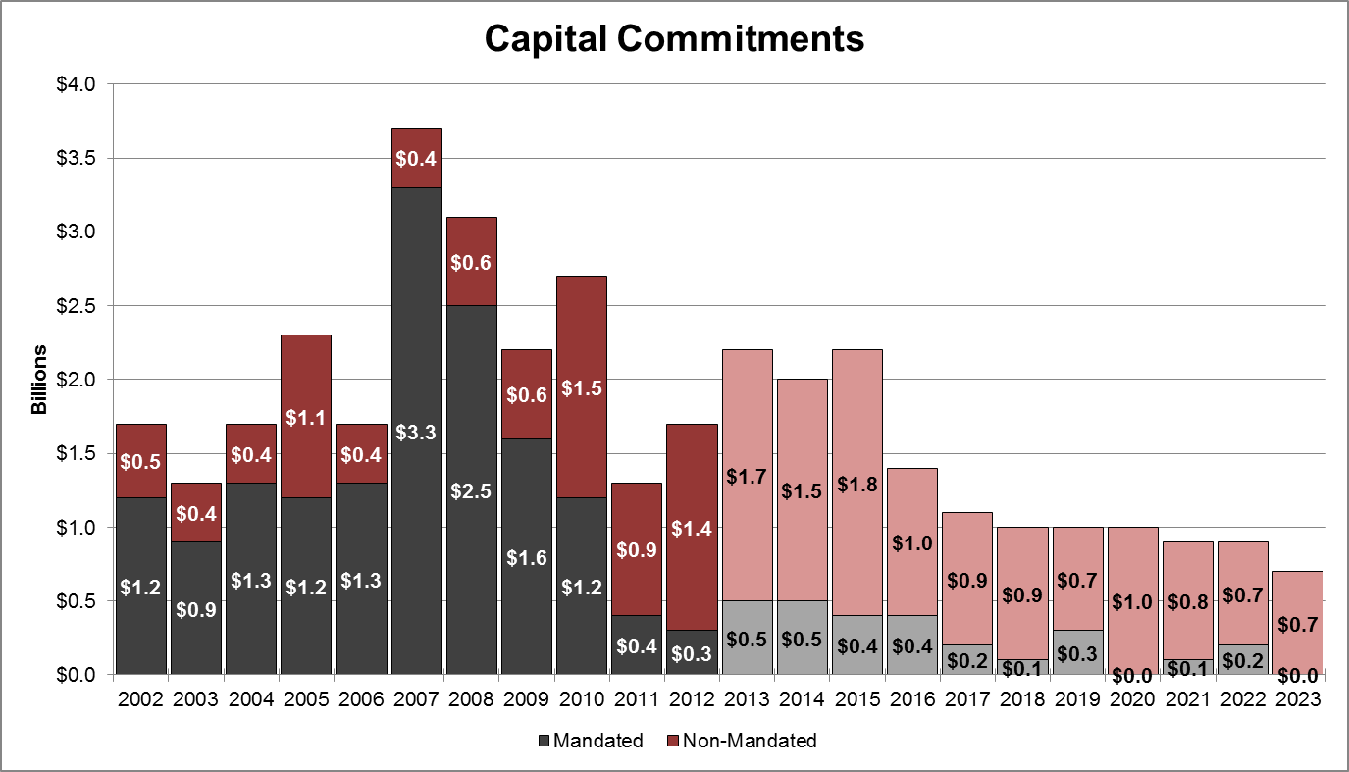
Mandates and Capital Costs
$15.2B (65%) of capital commitments were mandated
$2.6B (18%) Capital Improvement Plan is mandated allowing for non-mandated investment in State of Good Repair projects at treatment plants, flooding control, and replacement of water and sewer lines and rate relief?
Actual
Projected
Source: FY2014 Preliminary 10-Year Capital Plan

Slide 5
DEP’s Capital Priorities 2013-2023
DEP is investing over $10B in Capital Priorities in the next 10 years:
  Water for the Future – construction of shafts and tunnels for the Delaware Aqueduct repair $1.7B
  Asset management and state of good repair projects $5.1B
  Complete sewer connections in Queens $513M and Staten Island $473M
  Citywide water main and sewer contracts $831M
  Continue green infrastructure related projects $730M
  North River cogeneration project $212M
  Complete City Water Tunnel No. 3, Stage 2 Manhattan Section connections $208M
  Bring Bluebelts to southeast Queens to naturally control stormwater $62M
  Protecting wastewater infrastructure and accelerating drainage system build out in partially sewered or unsewered areas $545.3M

Slide 6
NYC Rate Increases
10%
decrease
35%
decrease
10%
decrease
28%
decrease
Water and Sewer Charges | FY 2014
Combined Water & Sewer Rate (per hundred cubic feet) | $9.27
Average Annual Single Family Charge (80,000 gal) | $991
Average Annual Multi-family Metered Charge (52,000 gal) | $644
Multi-family Conservation Program – Residential Unit | $944

Slide 7
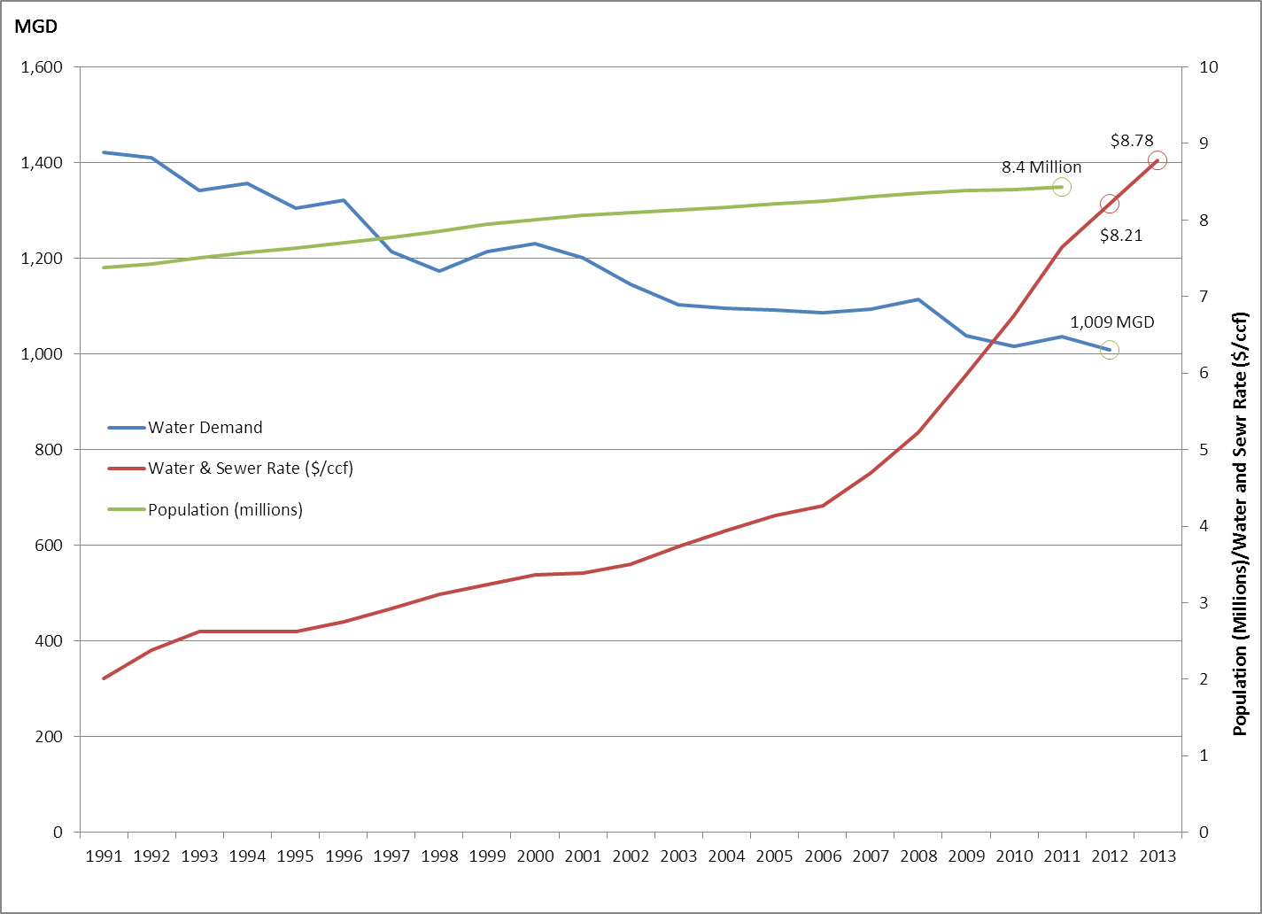
Consumption Declining, Rates Increasing
FY13: $3.39/CCF for water, $5.39/CCF for wastewater; $8.78/CCF combined.

Slide 8
Continuing the Dialogue on Affordability
Affordability Considerations should include:
  Income distribution
  Poverty rates, unemployment, % of income spent on housing costs and other non-discretionary spending, income and sales tax burden, etc…
  Financial Capability Guidance should be revisited through a stakeholder process to fully capture the financial picture of utilities and their ratepayers
  Environmental, social, and financial benefits of all water-related obligations to set priorities
  Focus limited resources where the community will get the most environmental benefit. Spend wisely to ensure attaining clean and safe drinking water goals

Slide 9
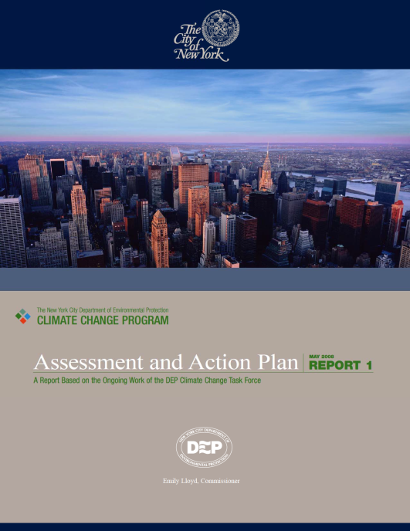
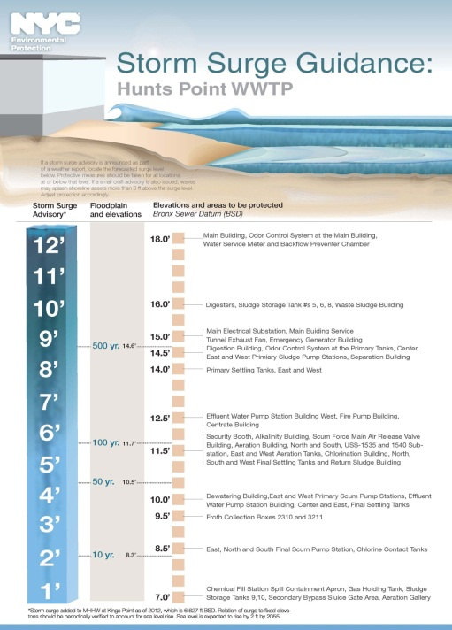
Climate Change Planning
Climate Change Task Force in 2004
2008 Climate Change Assessment and Action Plan
Model for the Mayor’s Climate Change Adaptation Task Force and the New York City Panel on Climate Change, formed in 2008
What is working today? Implement adjustments and adaptations to DEP programs and operations.
Pre-Sandy study of a representative WWTP, PS, and drainage area
Expanded citywide analysis of wastewater infrastructure to be more prepared and protected
National leadership: Water Utility Climate Alliance, NY Water Environmental Alliance.

Slide 10
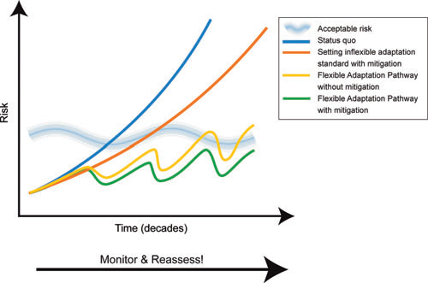
Climate Resiliency Study
Adaptation can come in many forms:
    Adjust operations and management
    Invest in Asset Resiliency
    Make flexible policies
    Revise design standards
    Pursue no-regrets strategies
Source: New York City Panel on Climate Change

Slide 11
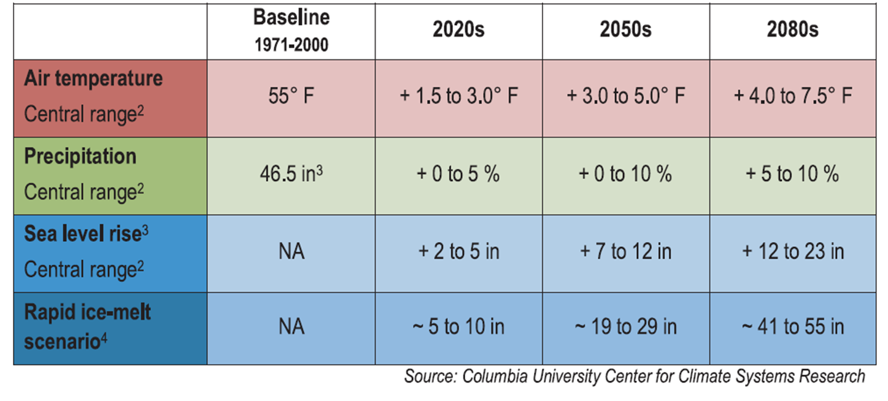
Climate Change in NYC

Slide 12
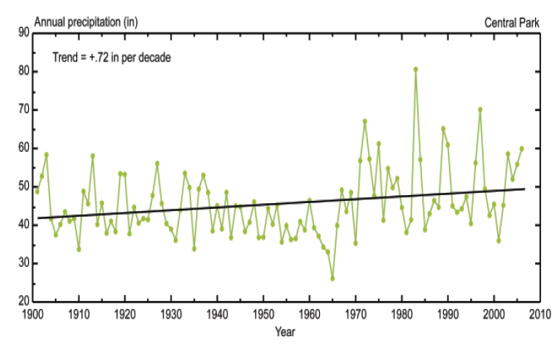
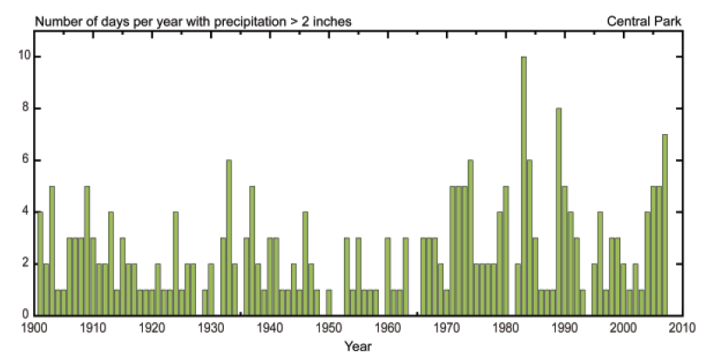
NYC Precipitation Trends
Inter-annual variability of precipitation has become more pronounced
Precipitation seems to be coming in the form of more intense storms
Source: New York City Panel on Climate Change
Notes:
12

Slide 13
Projecting Vulnerabilities
Source: MPCC

Slide 14
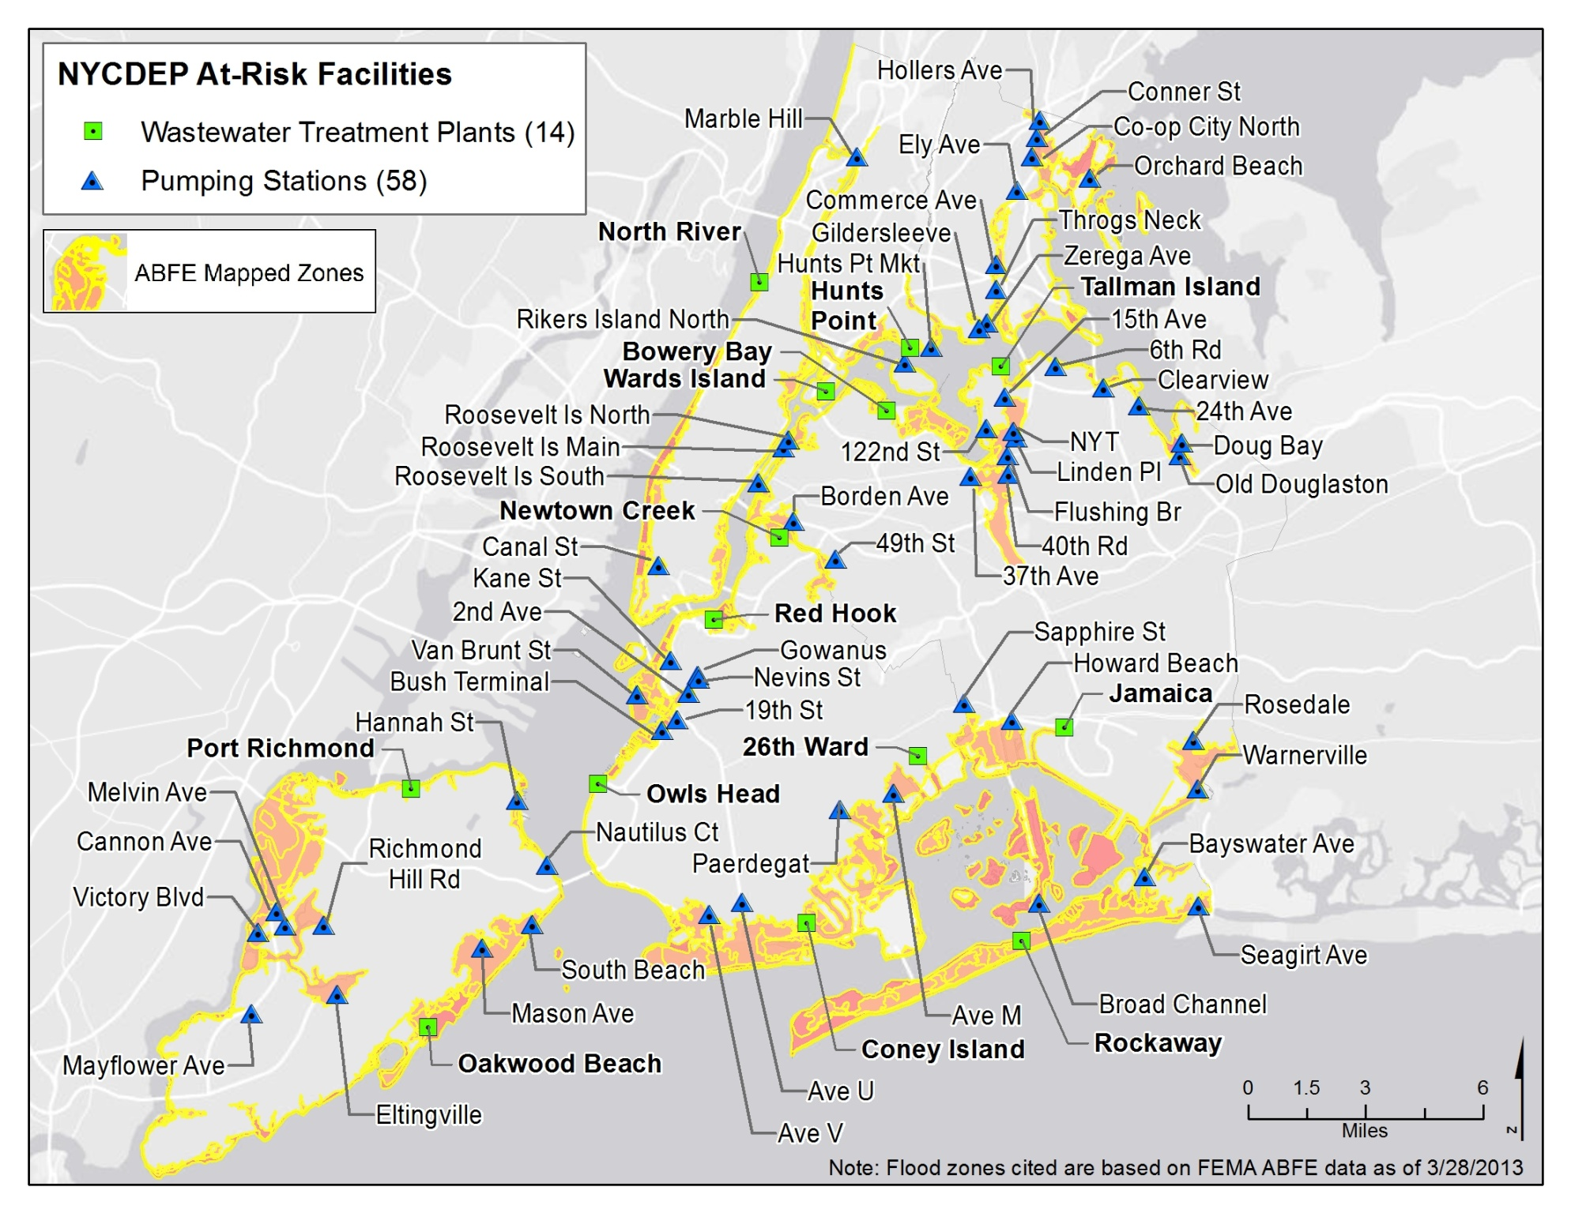
NYC DEP At-Risk Wastewater Facilities

Slide 15
WWTP Prioritization Approach
Prioritization considered against five metrics:
Beaches Impacted
Potential Damage Cost of At-Risk Assets
Primary At-Risk Assets Associated with Meeting Permits and goals
Total At-Risk Assets
Capital Plan Opportunities
Vulnerability
Metrics
Operational
Metrics
Other
Metrics

Slide 16
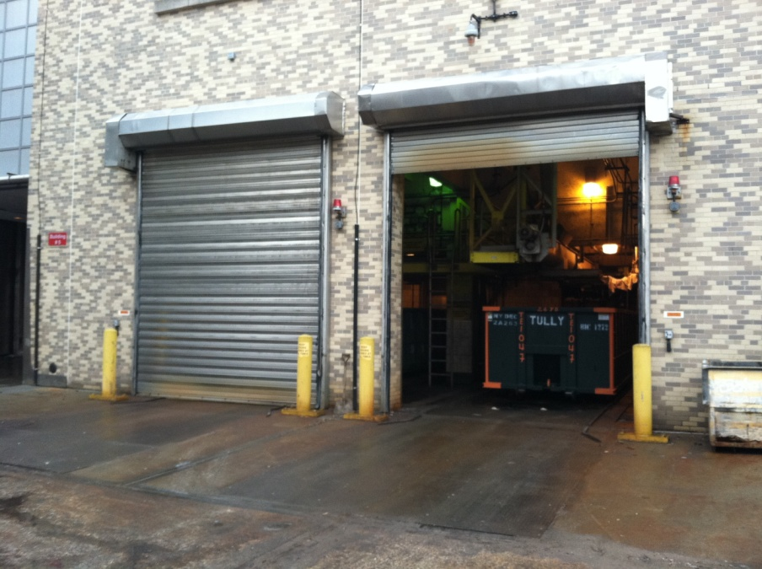
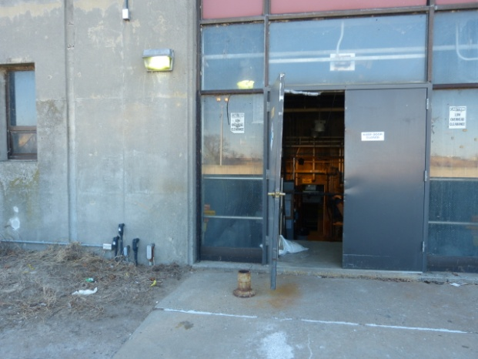
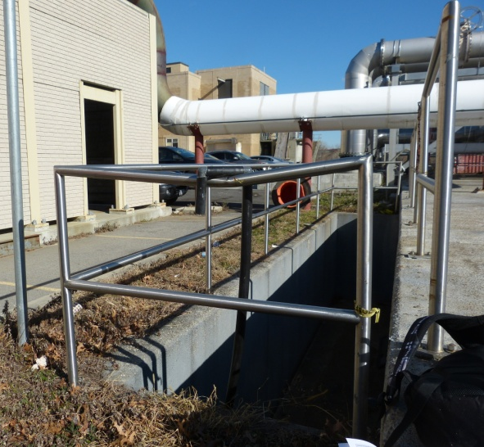
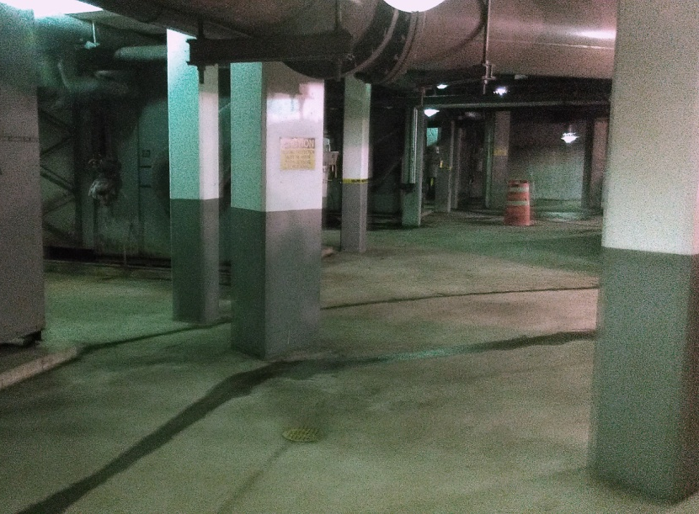
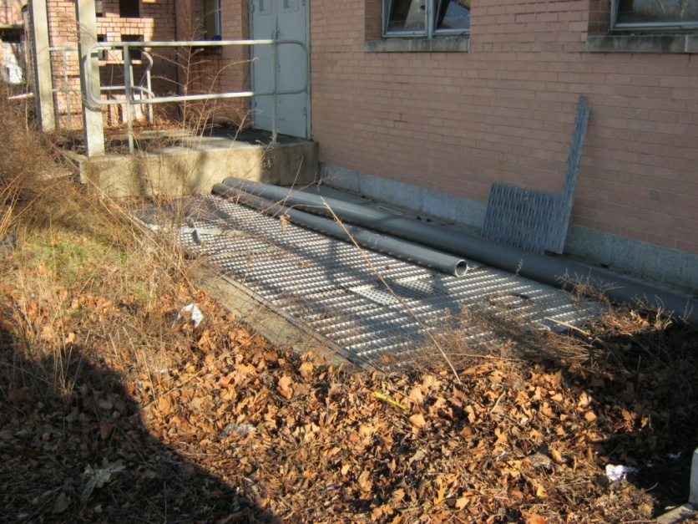
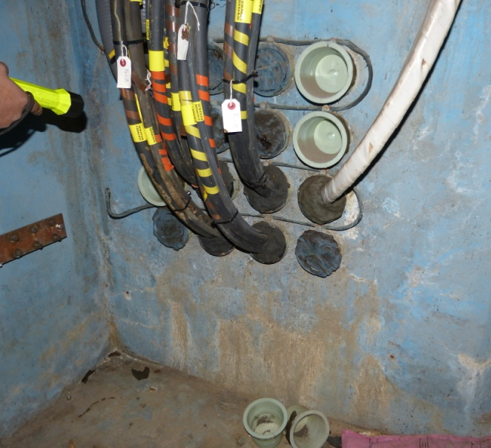
Building-Level Vulnerability Assessment
Each facility investigated and analyzed for flood pathways and threshold elevations.
Locations identified as at-risk if associated critical threshold elevations are below the assigned flood elevation (100-yr ABFE + 30-inches SLR).
Rollup Doors
Doorways & Windows
Areaways
Electrical Conduits and Manholes
Tunnels
Grates

Slide 17
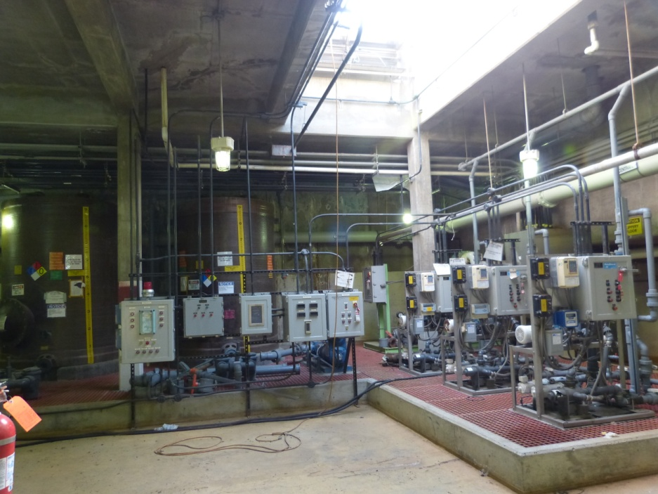
Asset-Level Vulnerability Assessment
Target Assets include All Active:
  Equipment associated with primary treatment at WWTP and pumping at PS
  Electrical equipment
  Pumps and motors
Target asset identified as at-risk if located in at-risk location, situated below the assigned flood elevation (100-yr ABFE + 30-inches SLR), and are not submersible.
Electrical assets located underground in the RAS Gallery at 26th Ward WWTP.

Slide 18
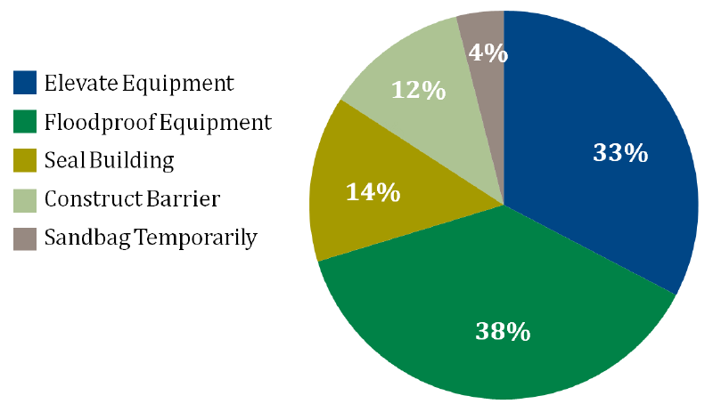
Recommended Strategy Allocation for WWTPs

Slide 19
PS Prioritization Approach
Prioritization considered against seven metrics:
Historic frequency of flooding
Recurring loss of power
Daisy chained or grouped facilities
Tributary population
Number of critical facilities in service area
Beaches?
Part of Capital Plan?
Operational
Metrics
Vulnerability
Metrics
Other
Metrics

Slide 20
Breakdown of 58 At-Risk PS
PS was considered at-risk if the local grade elevation was below the assigned flood elevation (100-year ABFE + 30 inches SLR)
PS Type | Above Ground | Below Ground | Total
Sanitary | 23 | 15 | 38
Combined | 14 | 4 | 18
Storm | 1 | 1 | 2
TOTAL | 38 | 20 | 58*
*NOTE: Gowanus and Ave. V pump stations are at-risk of inundation but have been excluded from further analysis as both are currently under construction. Thus only 56 PS were evaluated.

Slide 21
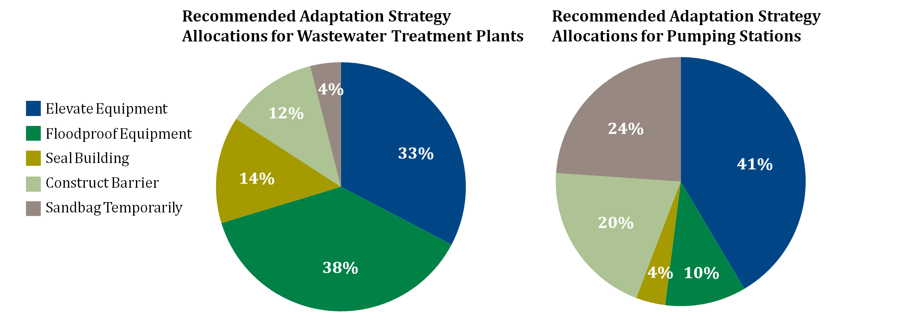
Recommended Strategy Allocations for PS
And Backup Power Generation
4%

Slide 22
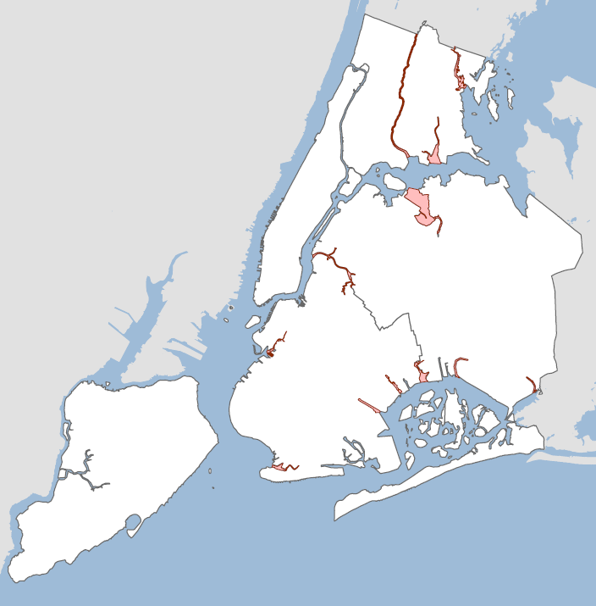
Water Quality in New York City Harbor
= does not meet water quality standards
75% of Harbor meets pathogen standards for swimming
19% meets standards for boating, fishing
7% of our Harbor is made up of tributaries that do not meet secondary contact standards

Slide 23
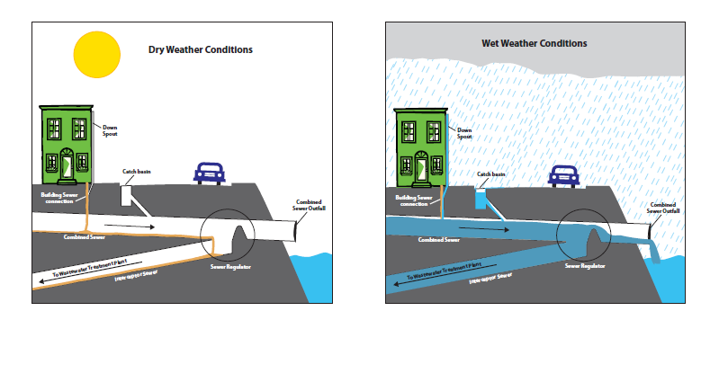
Wet Weather May Result in CSOs

Slide 24
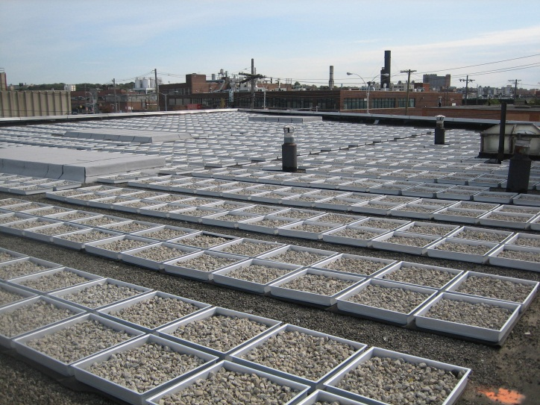
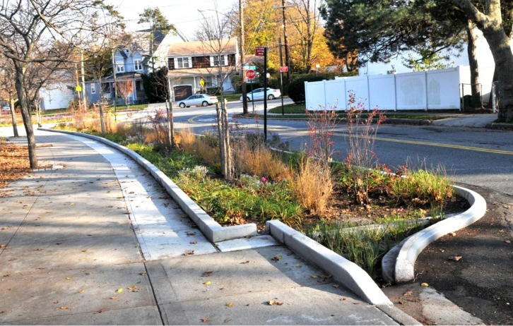
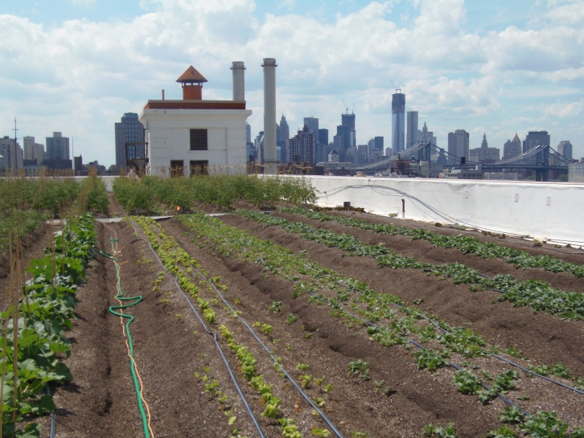
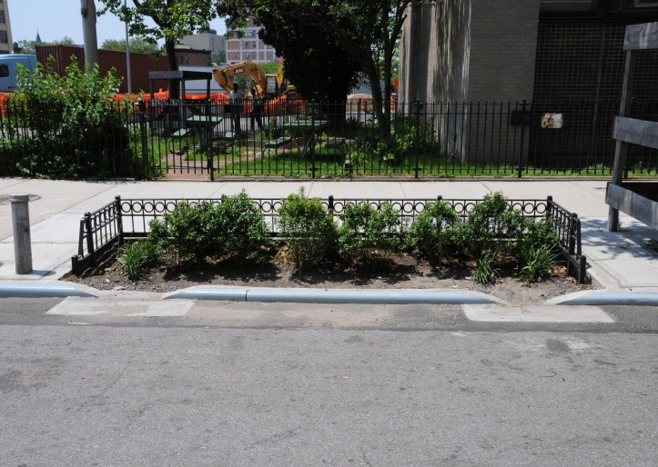
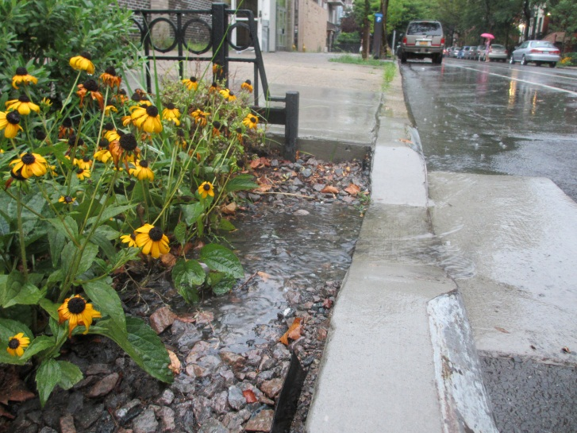
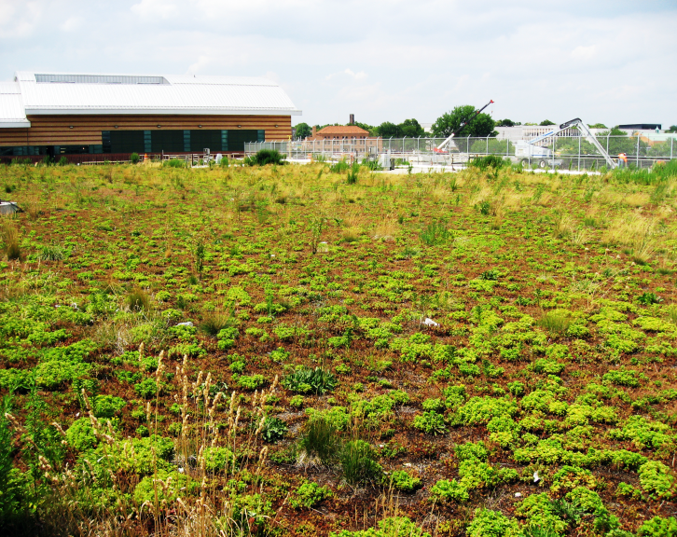
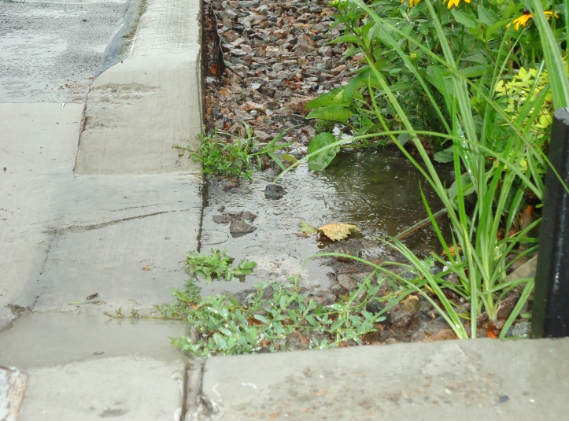
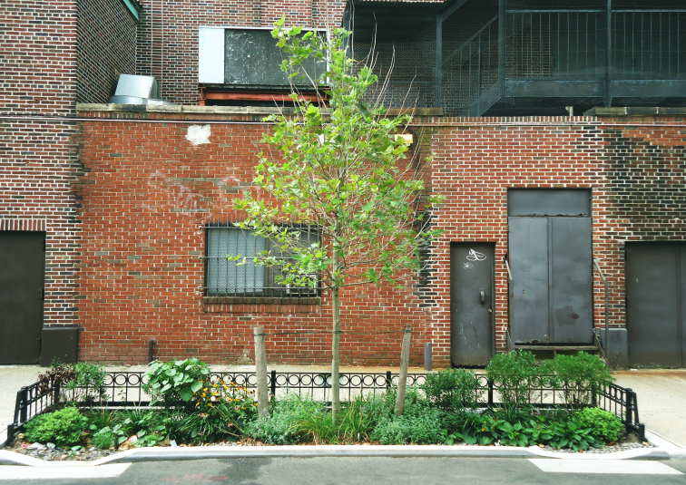
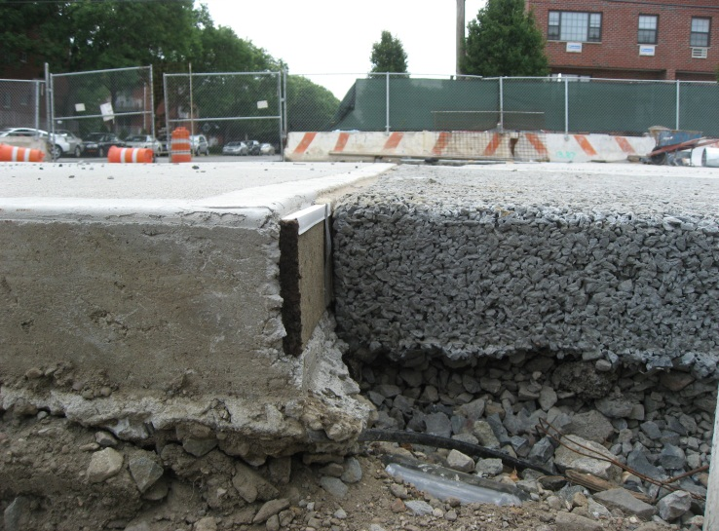
NYC Green Infrastructure

Slide 25
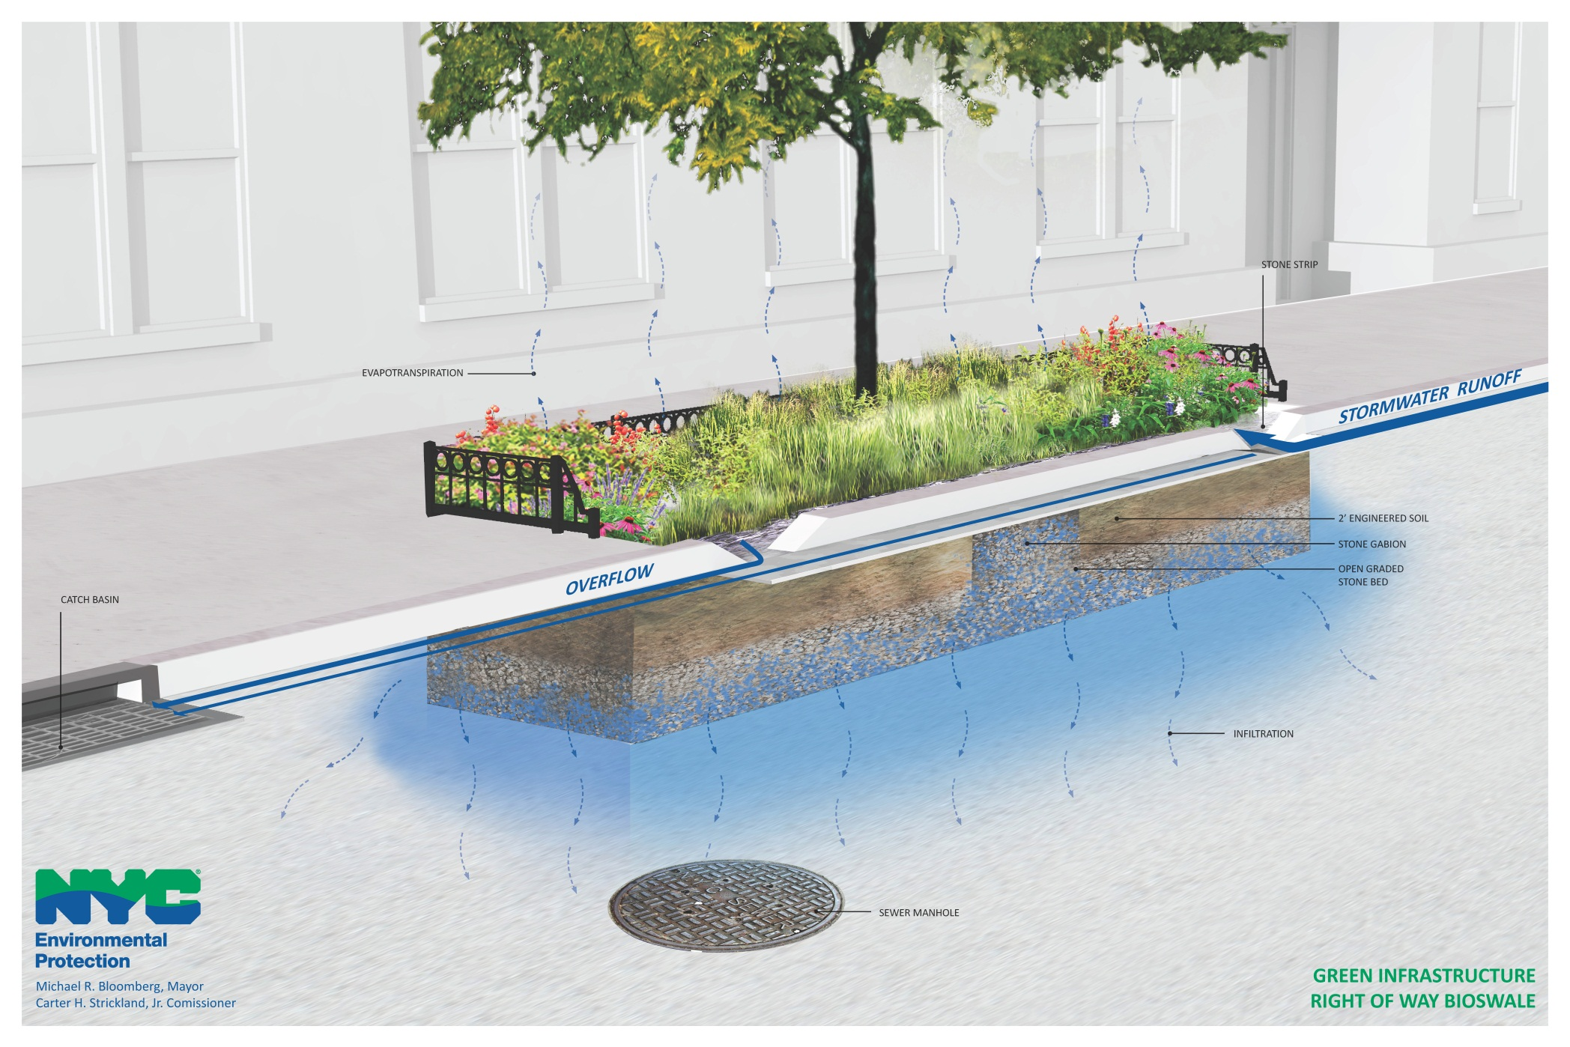
Right-of-way Bioswale

Slide 26
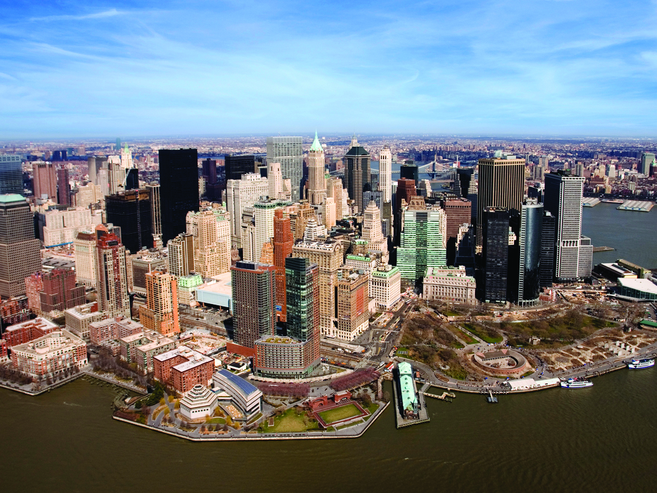
Thank You!
alicata@dep.nyc.gov
http://www.nyc.gov/dep

