Slide 1
Leveraging Technology to Achieve Healthcare Cost Efficiencies
An illustrative scenario analysis in selected populations in New York state
February 8th, 2019
April Semilla, Principal
april.semilla@ihsmarkit.com
862.588.1502

Slide 2
Big Tech and the Healthcare Industry
Relationship to date
Major potential disruptors to industry from healthcare tech space
Genomics and AI for diagnostics e.g. 23andMe for breast cancer test, Babylon Health AI
Wearables and Bio sensors e.g. Apple Watch 4, Smart Clothing
New developments in remote specialty care e.g. telehealth for monitoring high health risk populations, remote fitting for hearing aids
Which innovations will potentially have the most evident impact in the near term?
Case studies following have been calibrated to reflect impact on New York

Slide 3
Example I: Remote Specialty Care (Telehealth for Assisted Living Communities)
Study focused on medical records of population who are over 65 and residing in an assisted living community. Following inputs used in model for the scenario above:
110,259
Office visits made by residents 65+ in assisted living communities in NY in 1 year
$120 - $170
Cost of office visits
(low acuity)
38%
Of office visits could be replaced by telehealth virtual visits
$40 - $50
Cost of virtual visits

Slide 4
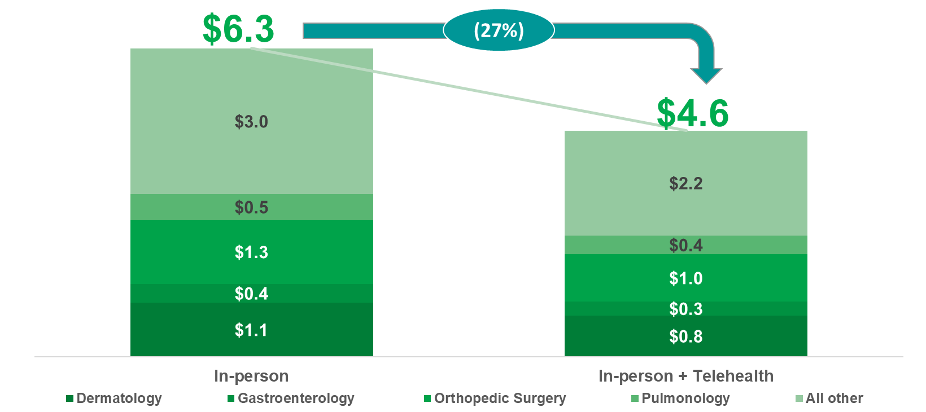
Office visit replacement could yield 27% cost reduction, equivalent to a potential 1 year savings of $1.7M in the NY Assisted Living Community

Slide 5
Example II: Wearables and Biosensors (Smart Insole for Diabetic Foot Ulcers)
Study focused on the impact of a smart insole on costs associated with diabetic foot ulcers (DFU) and resulting complications vs. costs incurred with standard of care (SOC). Following inputs used in model for this scenario:
1,429,706
Projected number of people with diabetes in NY in 2019
89,834
Projected # of cases of foot ulcer cases in NY in 2019
Average incidence of foot ulcers in persons who have diabetes
7.3%
~$9K - $20K
Costs associated with treating DFU

Slide 6
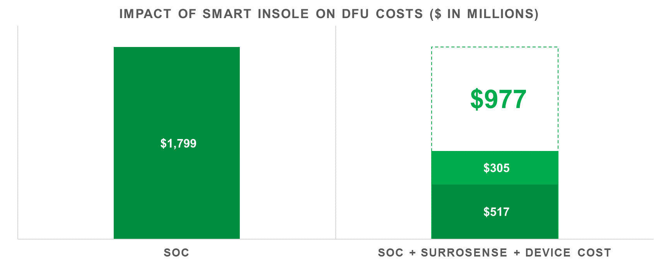
Implementing smart insole technology in the treatment for DFU could generate ~$1 billion of savings for NY in 1 year
Potential savings
Reflects the higher rate of DFU under SOC
Cost of device ($3,399 each set of insoles + watch, monitoring system)
Cost of health care e.g. doctor’s visits

Slide 7
Wrap Up
Technologies that focus on high cost populations or conditions have the potential for large sea change in healthcare costs associated with treatment
Other methods for finer level analysis to estimate the impacts of technological innovations
Microsimulation modeling

